Slide 1
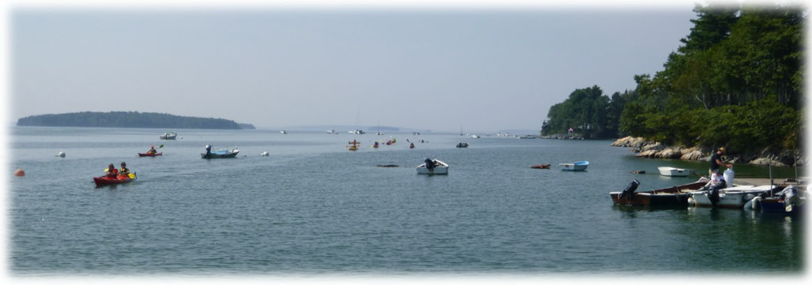
Mooring Use in Brunswick Waters
Types of Moorings used along the Brunswick Coastline

Slide 2
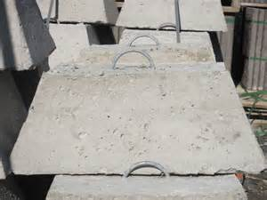

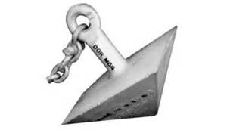
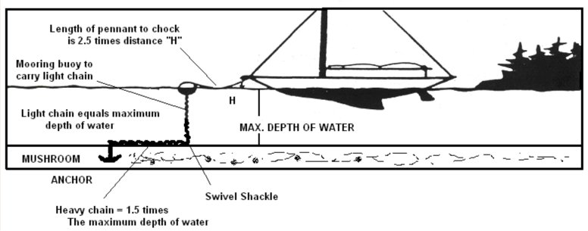
Traditional Style Moorings
Block (Dead Weight)
Mushroom
Dor-mor

Slide 3
Traditional Moorings Continued
- Mushroom anchors are the most common anchors in Brunswick because they are designed for use along areas with softer seabed's such as mud, sand or silt. They are shaped like an upside-down mushroom which can be easily buried in mud or silt. The advantage is that it has up to ten times the holding-power-to-weight ratio compared to a dead weight mooring; disadvantages include high cost, limited success on rocky or pebbly substrates, and the long time it takes to reach full holding capacity
-Dead weights are the simplest type of anchor. They are generally made as a large concrete block with a rode attached which resists movement with sheer weight; and, to a small degree, by settling into the substrate. In some areas along our coast you may find old iron wagon wheels, motor vehicle engines, granite, etc… The advantages are that they are simple and cheap. A dead weight mooring that drags in a storm will still hold in its new position. Such moorings are better suited to rocky/hard bottoms where other mooring systems do not hold well. The disadvantages are that they are heavy, bulky, and awkward.
- Dor-Mor (Pyramid anchors) are pyramid-shaped anchors. They work in the upside-down position with the apex pointing down at the bottom such that when they are deployed, the weight of wider base pushes the pyramid down digging into the floor. As the anchors are encountered with lateral pulls, the side edges or corners of the pyramids will dig deeper under the floor, making them more stable

Slide 4
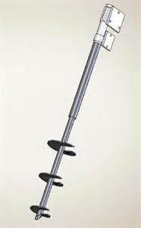
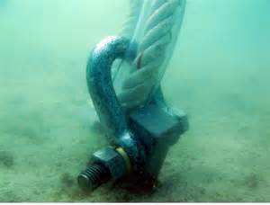
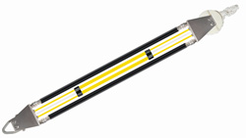
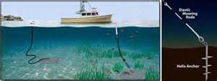

Non Traditional Style Moorings
Screw in Anchors
-Screw-in moorings are a modern method. The anchor in a screw-in mooring is a shaft with wide blades spiraling around it so that it can be screwed into the substrate. The advantages include high holding-power-to-weight ratio and small size (and thus relative cheapness). Environmentally friendly to the ocean bottom, with minimal disruption or impact. The disadvantage is that a diver is usually needed to install, inspect, and maintain these moorings which drives the cost up.

Slide 5
Mooring Placement
DETERMINING MOORING PLACEMENT:
Water availability near abutting property
Is there an appropriate place in the subtidal within reasonable proximity to the abutting property/mooring applicant?
Navigation impacts
Is there any other navigation concerns at any tidal stage. Does the mooring encroach on defined channels?
Environmental Impacts
Are there any environmental concerns, does the boat have breathing and a head? Does the boat present any other environmental concerns? Location of nearby mapped aquatic vegetation (eel grass), shellfish beds, aquaculture leases? Type of vessel, cargo, berthing, etc…
Natural Resource Impact
Will the location of the boat reasonably interfere with existing use of the fisheries (sport and commercial). Is the mooring located near any protected species habitat.

Slide 6
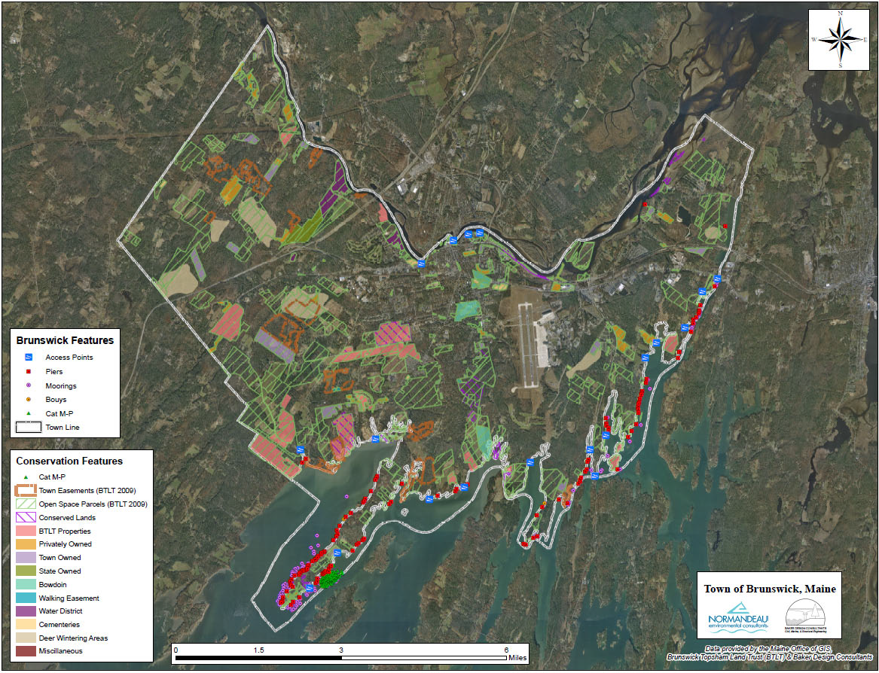
Mapped Brunswick Moorings

Slide 7
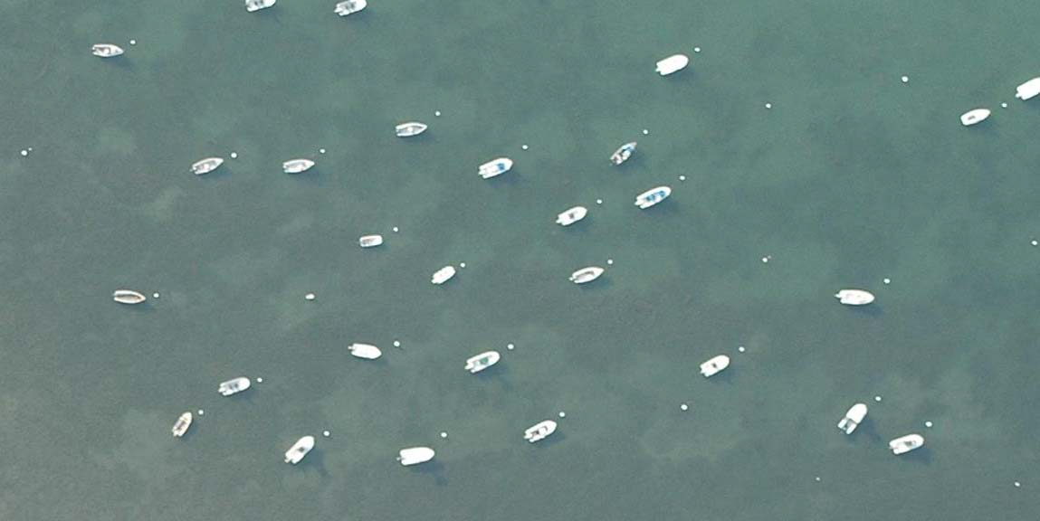
Aerial photograph showing damage to eelgrass from traditional moorings, Merepoint, Brunswick, Maine. Courtesy of John Sowles, Yarmouth, Maine.

