Slide 1
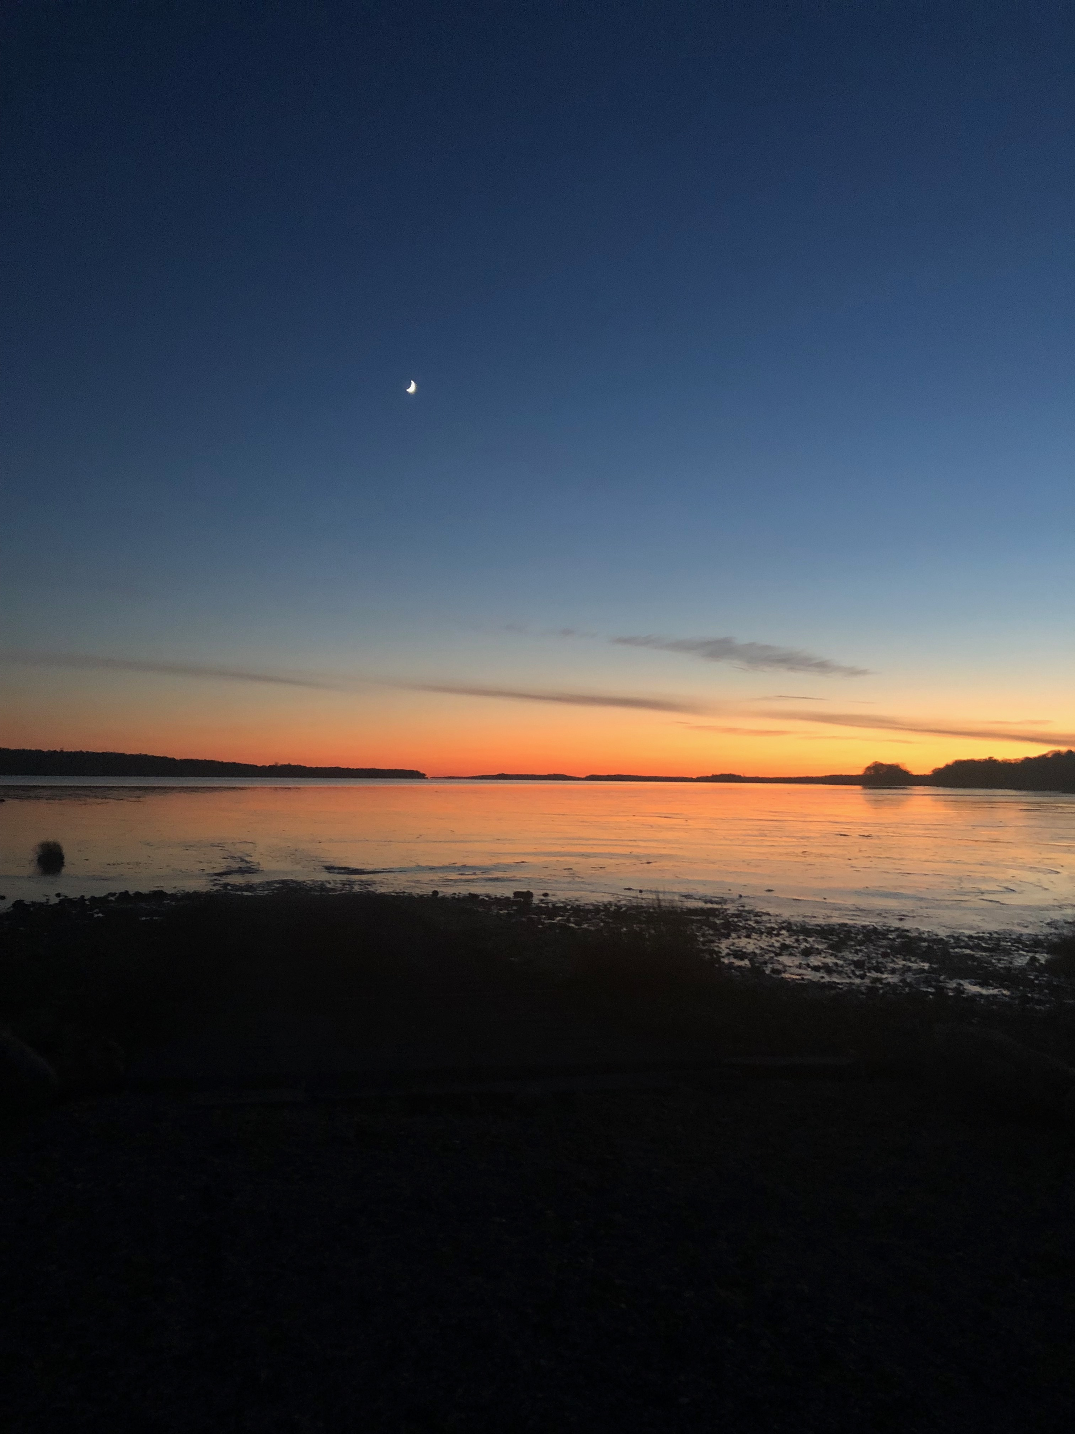
2023 Shellfish License Allocation

Slide 2
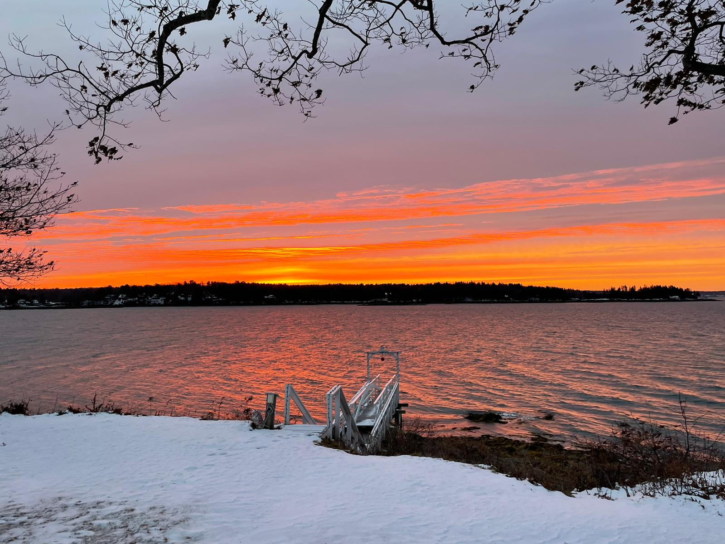
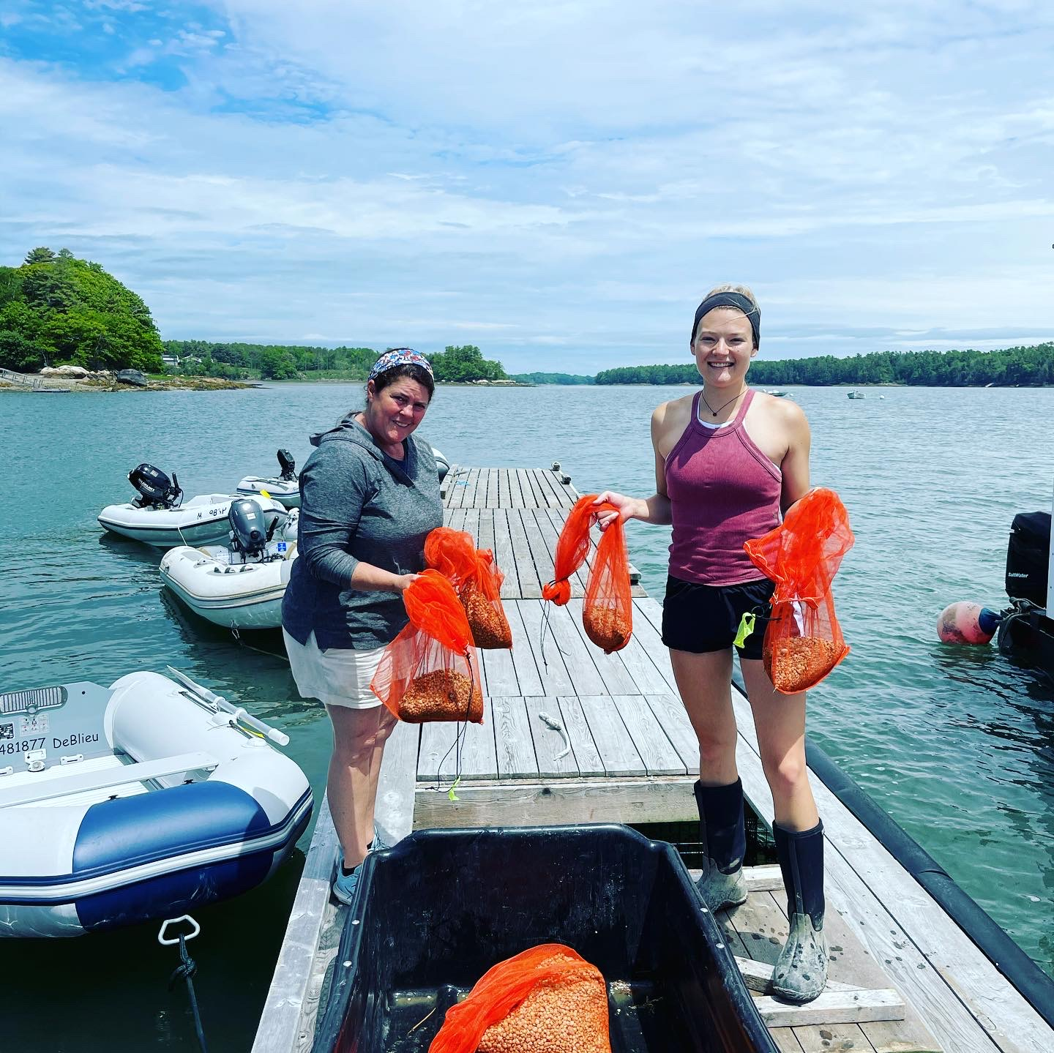
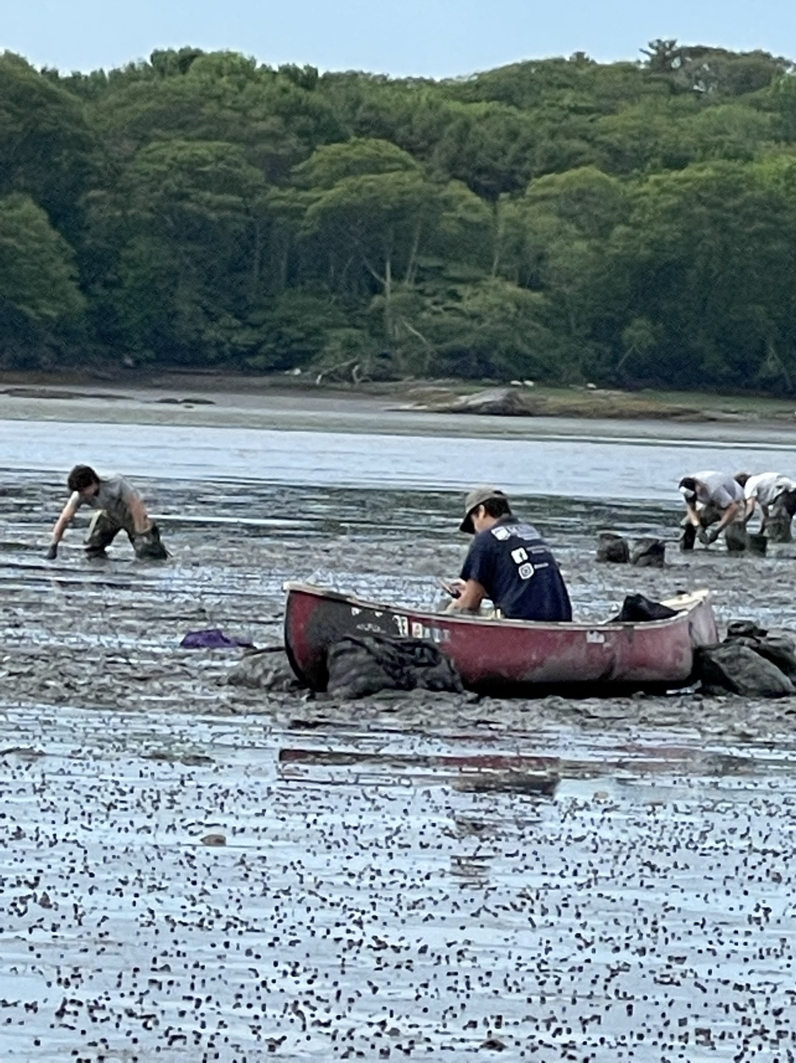
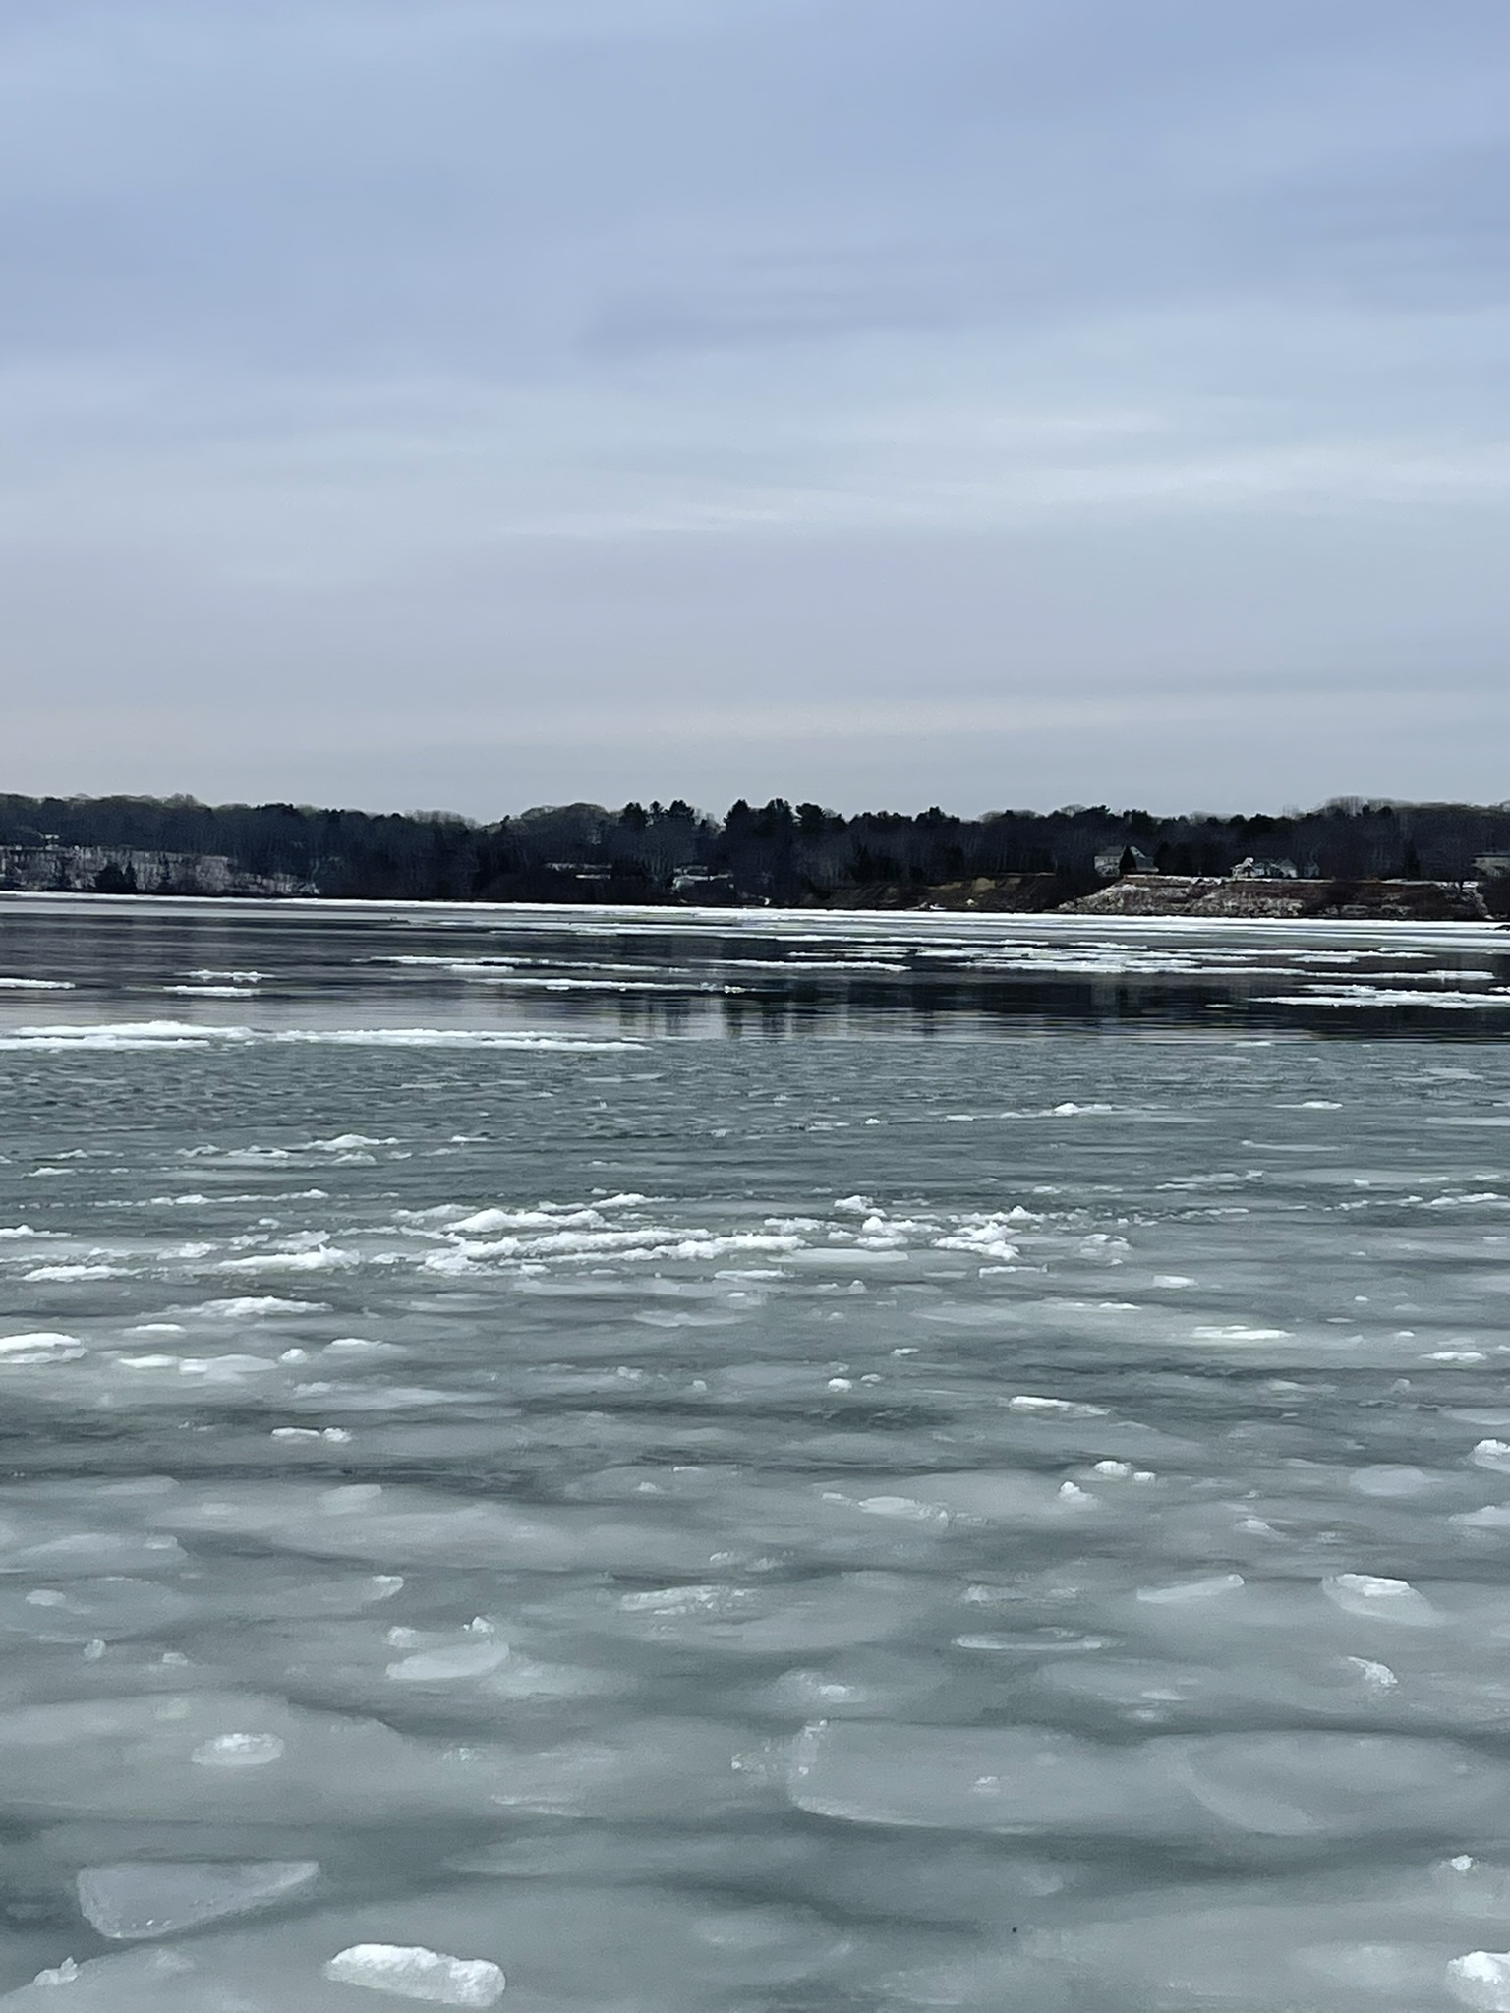
Agenda Item
Shellfish Survey & License Allocation Overview
- Committee Questions
Public Comment
- Questions and Comments from public
Committee Discussion
- Make License Allocation Recommendation ACTION ITEM

Slide 3
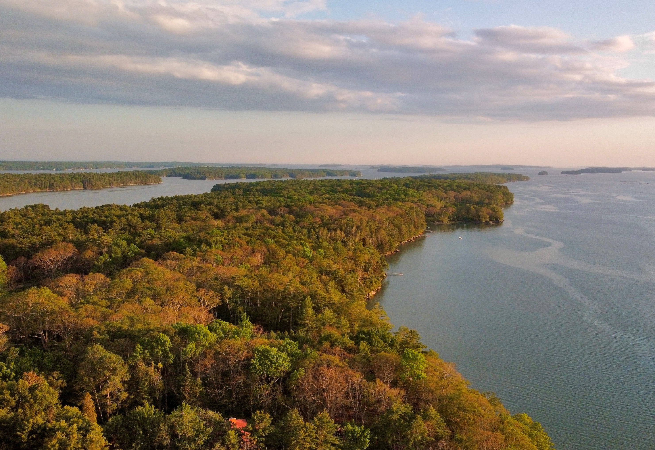
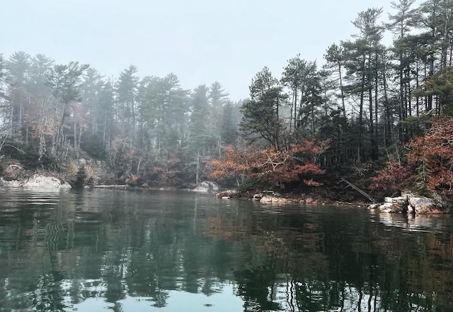
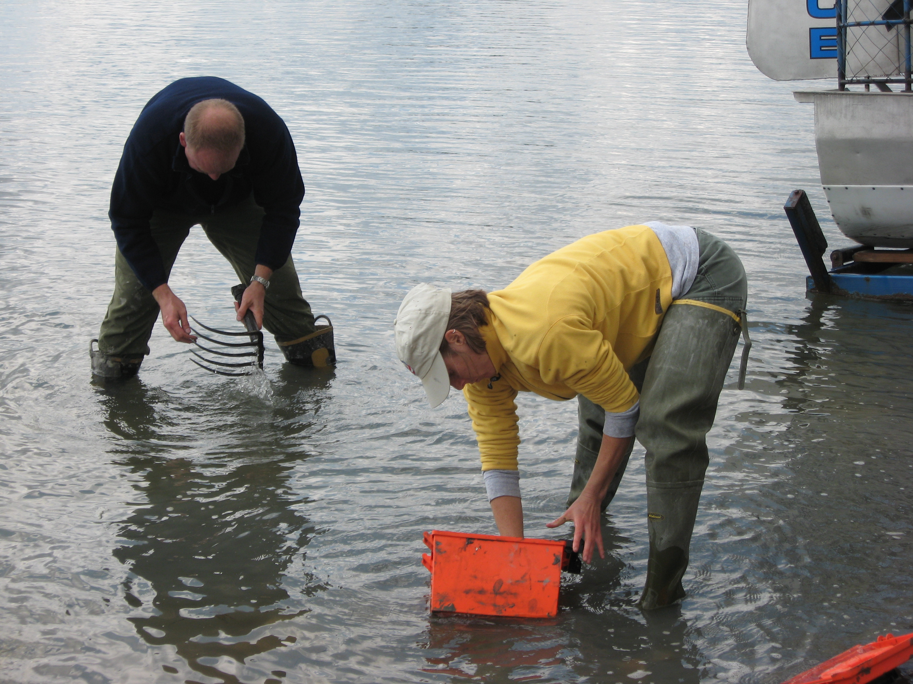
Survey Purpose
Shellfish Inventory Surveys are completed every other year.
The surveys determine an estimated standing crop.
The standing crop is used to determine the amount of resident commercial licenses to be issued +/- 15%

Slide 4
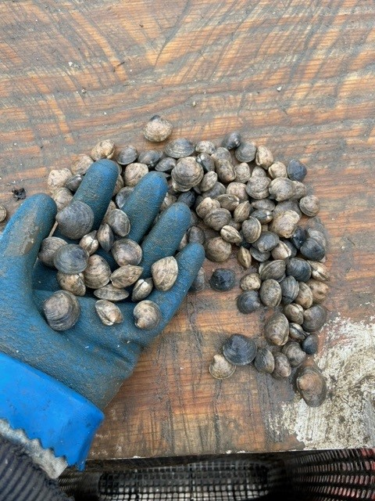
Hardshell Clam Overview
Northern Quahog (Mercenaria mercenaria)
Female Reproductive Rate 1-5 million eggs per spawning event
Climate Susceptibility MODERATE

Slide 5
Upper Middle Bay ~ Barnes Landing ~ Simpsons Point
Est. Standing Crop
1150

Slide 6
New Meadows River ~ Bull Rock ~ Horse Pen Cove
Est. Standing Crop
45

Slide 7
Bunganuc Shores
Est. Standing Crop
644

Slide 8
Clay Cove ~ Miller Creek ~ Catlin Shore
Est. Standing Crop
5075

Slide 9
Princess Point ~ Long Reach ~Buttermilk Cove
Est. Standing Crop
214

Slide 10
Maquoit Bay
Est. Standing Crop
7171

Slide 11
Thomas Point Beach
Est. Standing Crop
366

Slide 12
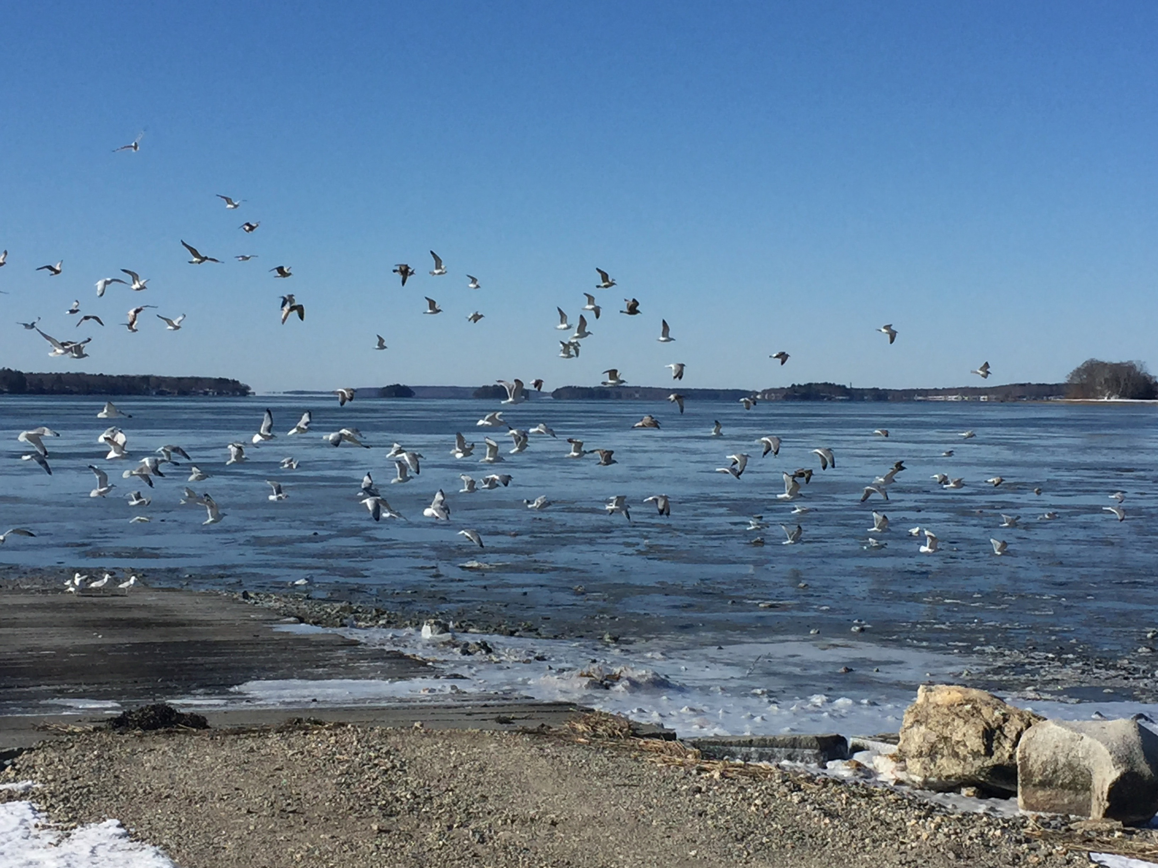
Sustainable Commercial Licenses Attributed to Hardshell Clam Populations
 | Standing Crop | Projected Harvest Days | Average Harvest | Sustainable Licenses
Hardshell Populations | 14666 Bushels | 209 Harvest Days | 1.5 Bushel / 1200pcs | 24

Slide 13
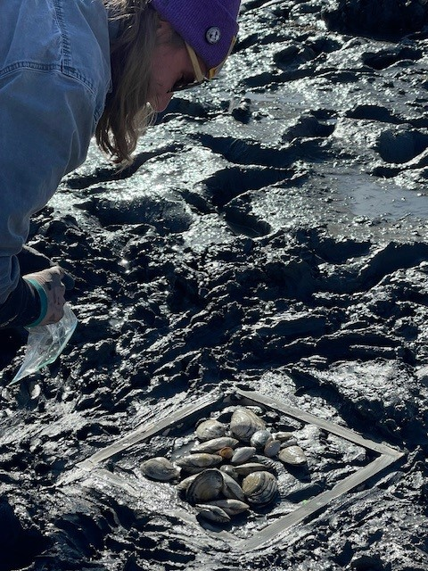
Softshell Clam Survey Overview
Softshell Clam (Mercenaria mercenaria)
Female Reproductive Rate 1-5 million eggs per spawning event
Climate Susceptibility HIGH

Slide 14
Upper Middle Bay ~ Barnes Landing ~ Simpsons Point
Est. Standing Crop
464

Slide 15
New Meadows River ~ Bull Rock ~ Horse Pen Cove
Est. Standing Crop
74

Slide 16
Bunganuc Shores
Est. Standing Crop
492

Slide 17
Buttermilk Cove
Est. Standing Crop
275

Slide 18
Clay Cove ~ Miller Creek ~ Catlin Shore
Est. Standing Crop
2426

Slide 19
Harpswell Cove
Est. Standing Crop
2765

Slide 20
Little Bullpen ~ Iron Island ~Northern Coombs
Est. Standing Crop
145

Slide 21
Long Reach ~ Gurnet Straits
Est. Standing Crop
196

Slide 22
Maquoit Bay
Est. Standing Crop
3570

Slide 23
Thomas Point Beach
Est. Standing Crop
5622

Slide 24
Smith Cove
Est. Standing Crop
270

Slide 25
Woodward Cove
Est. Standing Crop
249

Slide 26
Sustainable Commercial Licenses Attributed to Softshell Clam Populations
 | Standing Crop | Projected Harvest Days | Average Harvest | Sustainable Licenses
Softshell Populations | 16305 Bushels | 275 Harvest Days | 1.5 Bushel | 27

Slide 27
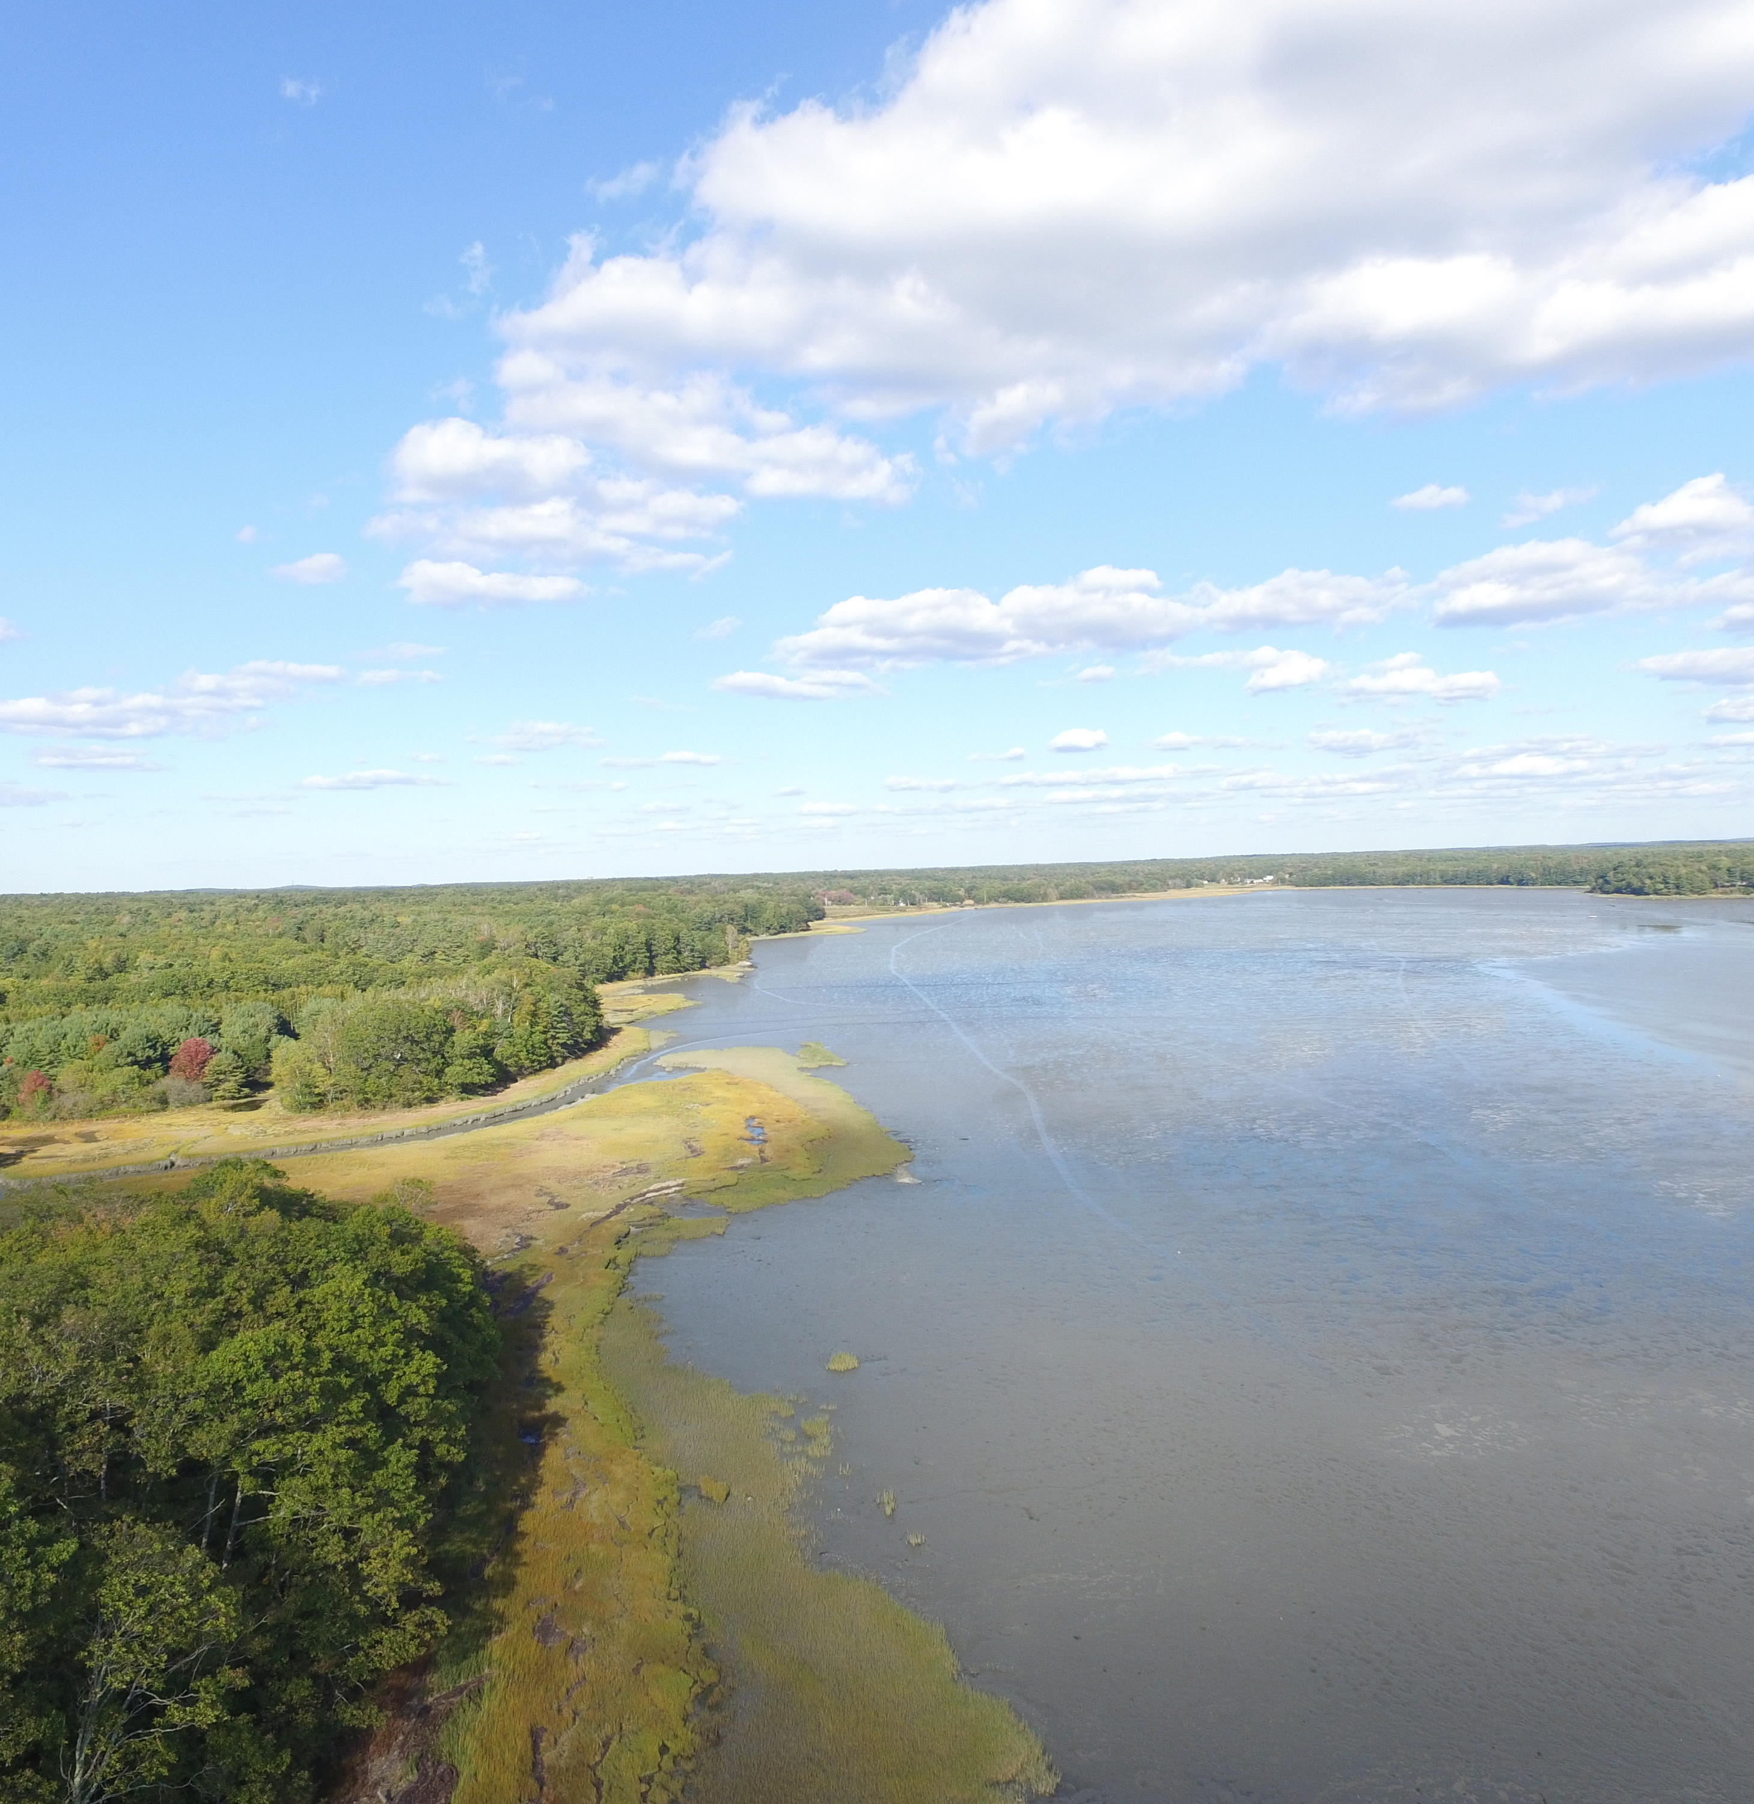
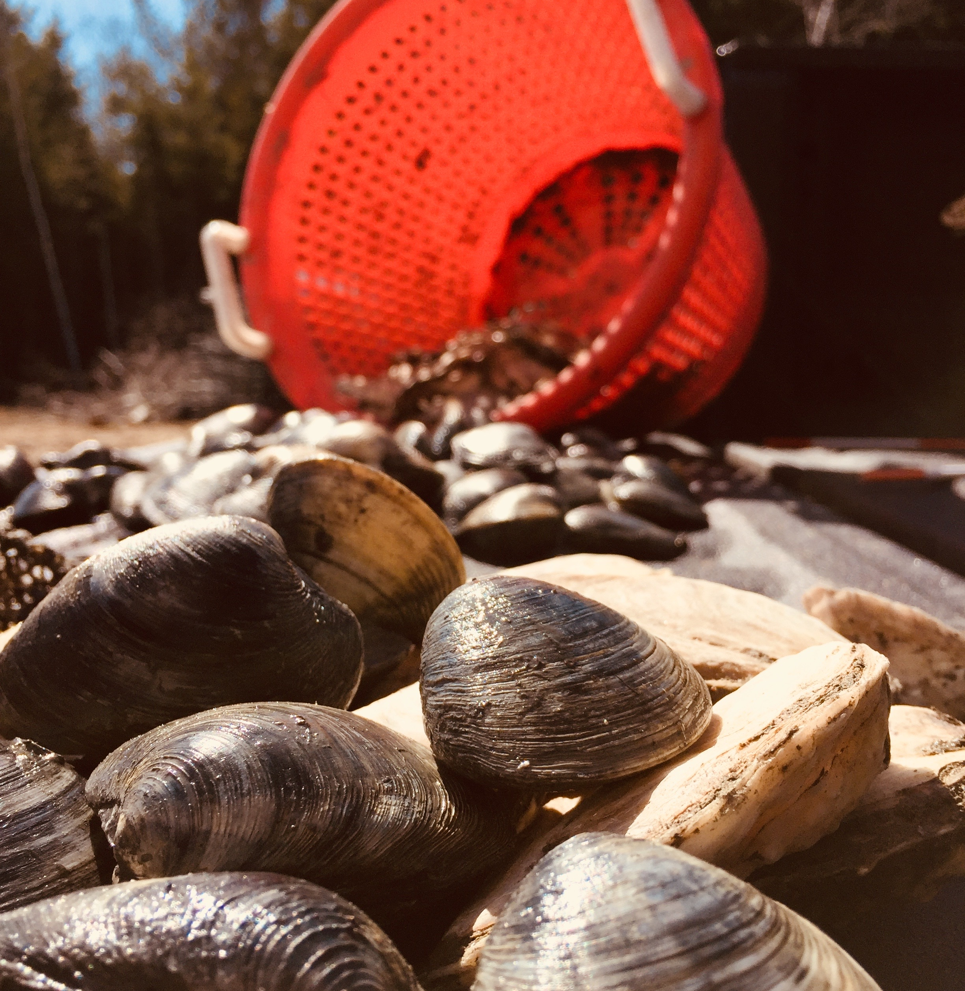
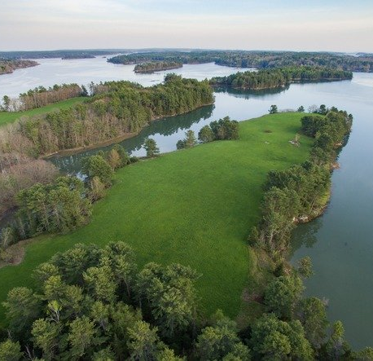
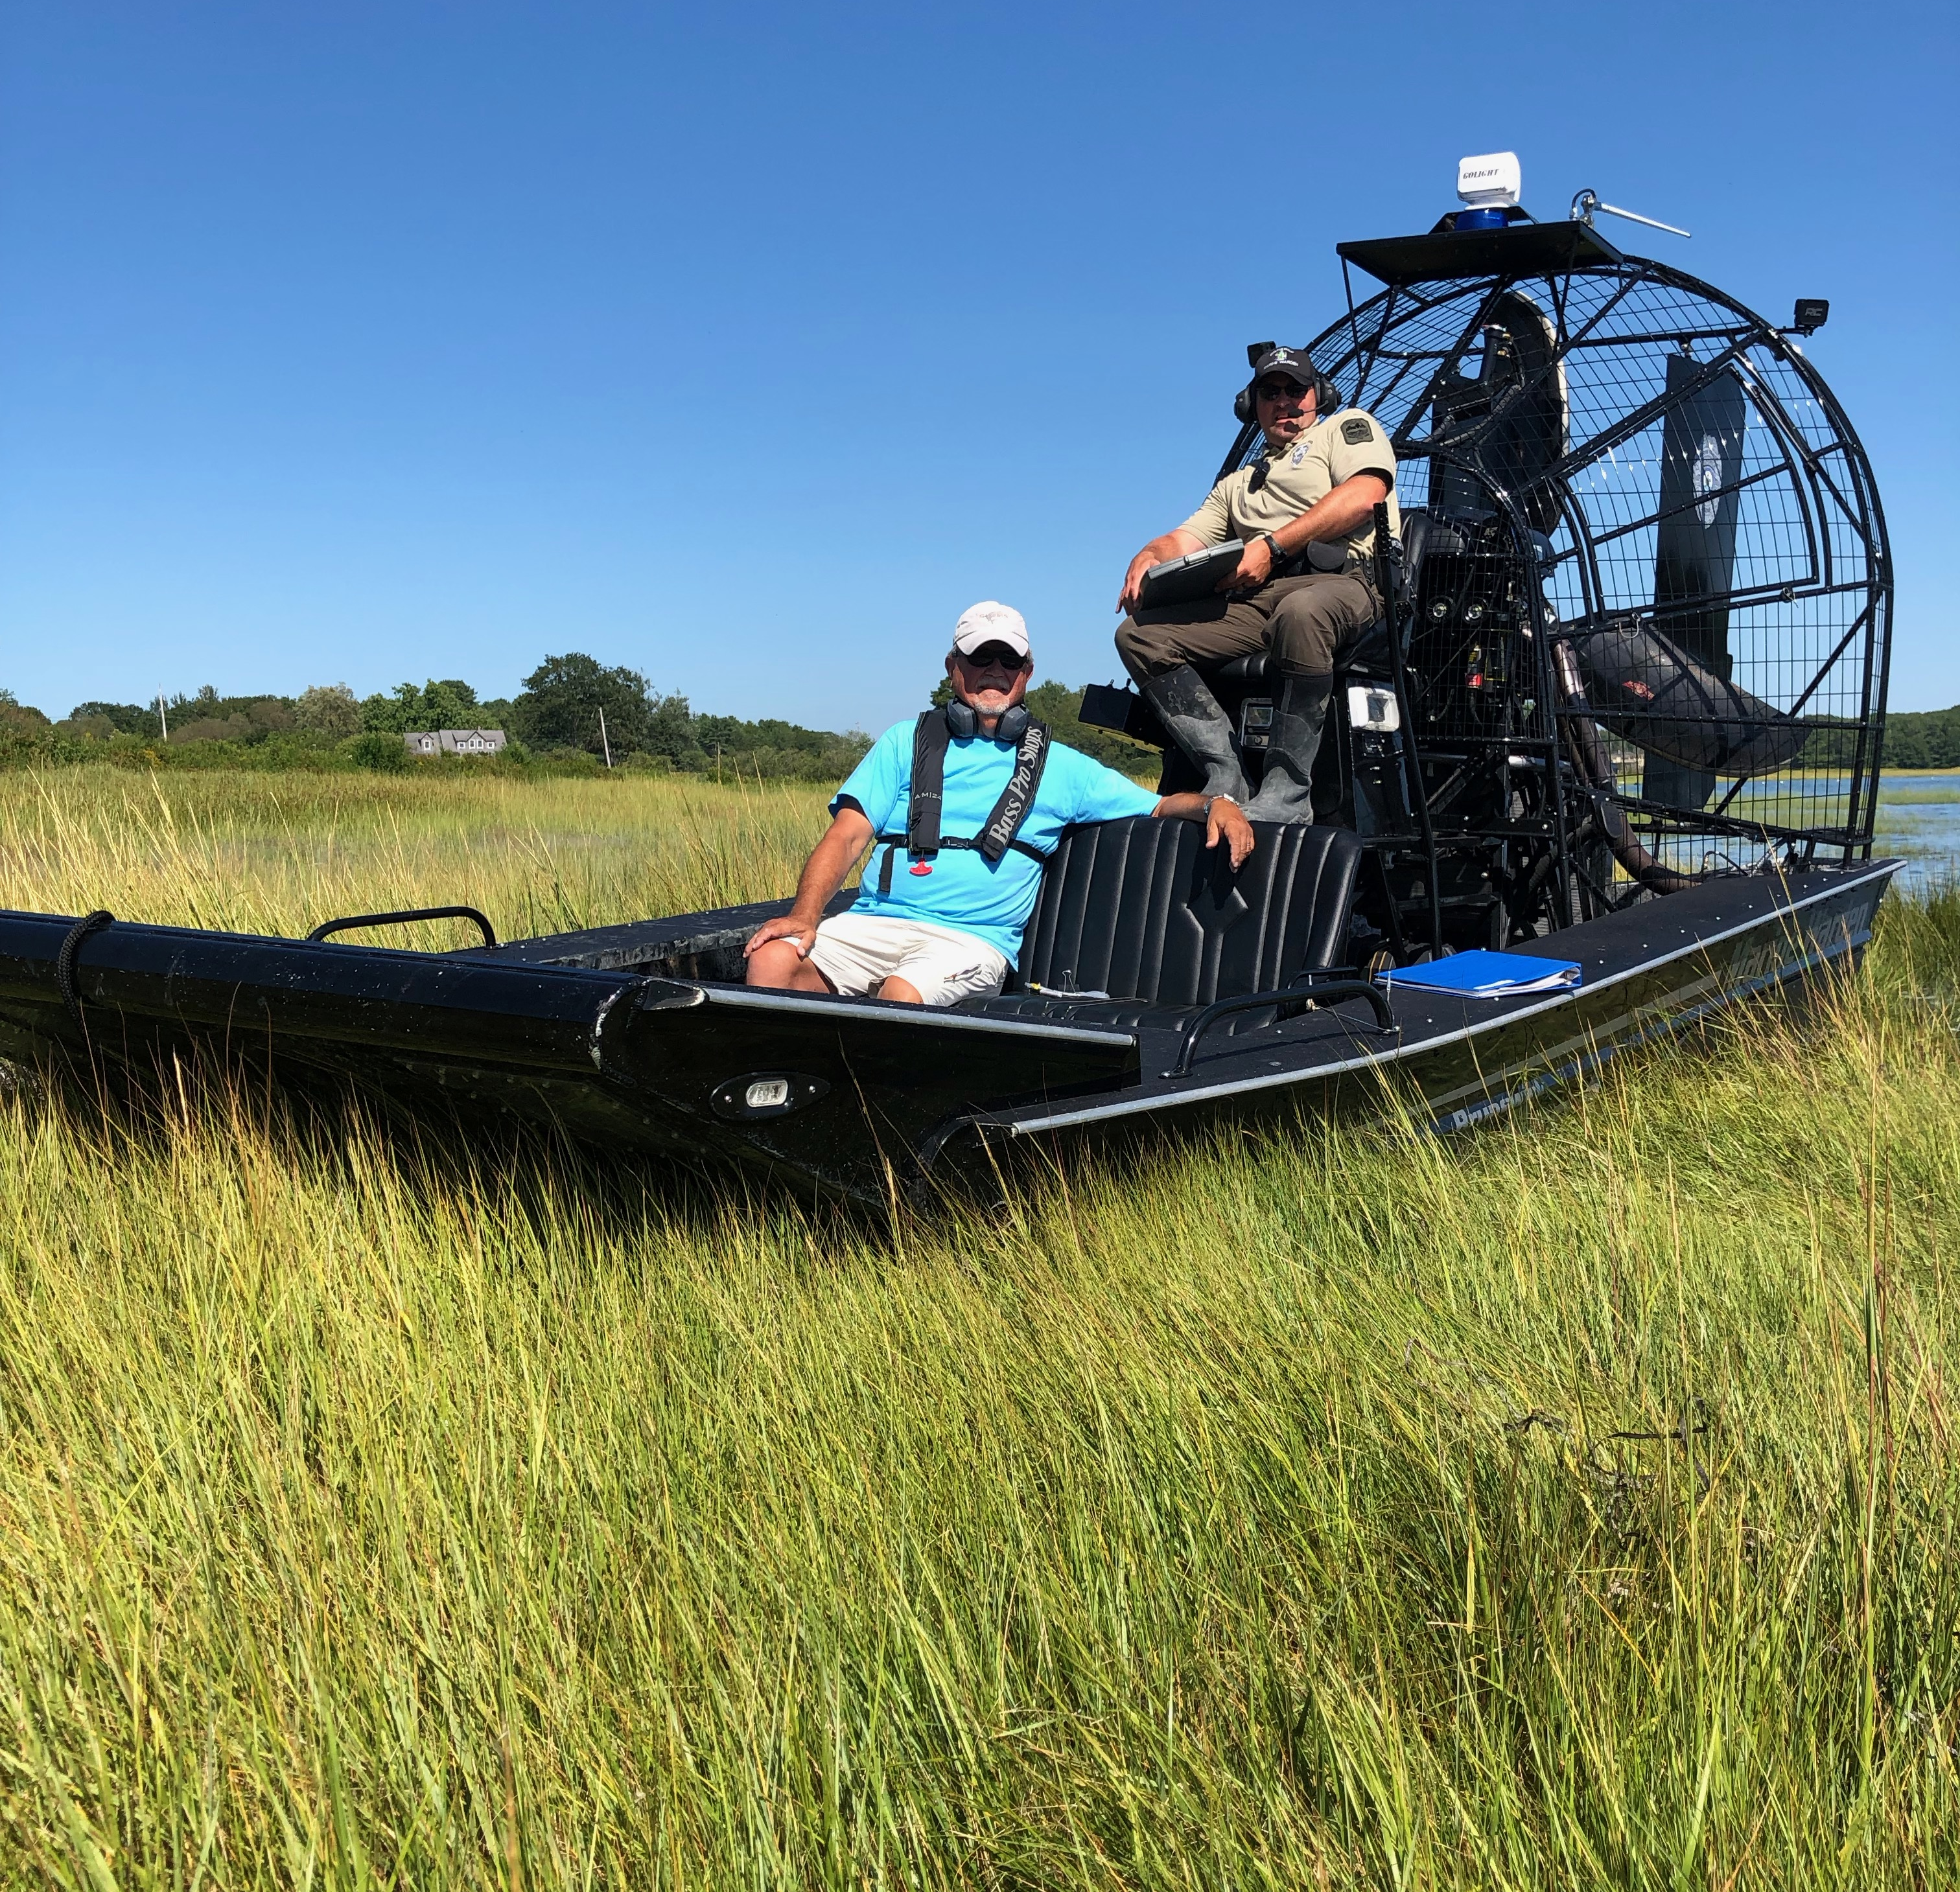
Historical Survey and Landing Data

Slide 28
2022 State Shellfish Landing Data

Slide 29
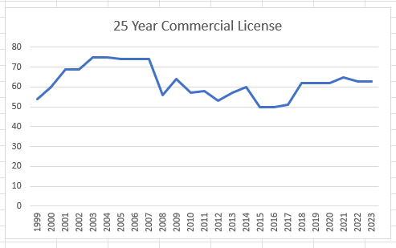
Commercial Shellfish License Allocations Resident and Non-Residents
1998-1999 = 54
1999-2000 = 60
2000-2001 = 69
2001-2002 = 69
2002-2003 = 75
2003-2004 = 75
2004-2005 = 74
2005-2006 = 74
2006-2007 = 74
2007-2008 = 56
2008-2009 = 64
2009-2010 = 57
2010-2011 = 58
2011-2012 = 53
2012-2013 = 57
2013-2014 = 60
2014-2015 = 50
2015-2016 = 50
2016-2017 = 51
2017-2018 = 62
2018-2019 = 62
2019-2020 = 62
2020-2021 = 65
2021-2022 = 63
2022-2023 = 63
2023-2024 = 63
2024-2025 = ??
25 Year Average = 62 Commercial Licenses

Slide 30
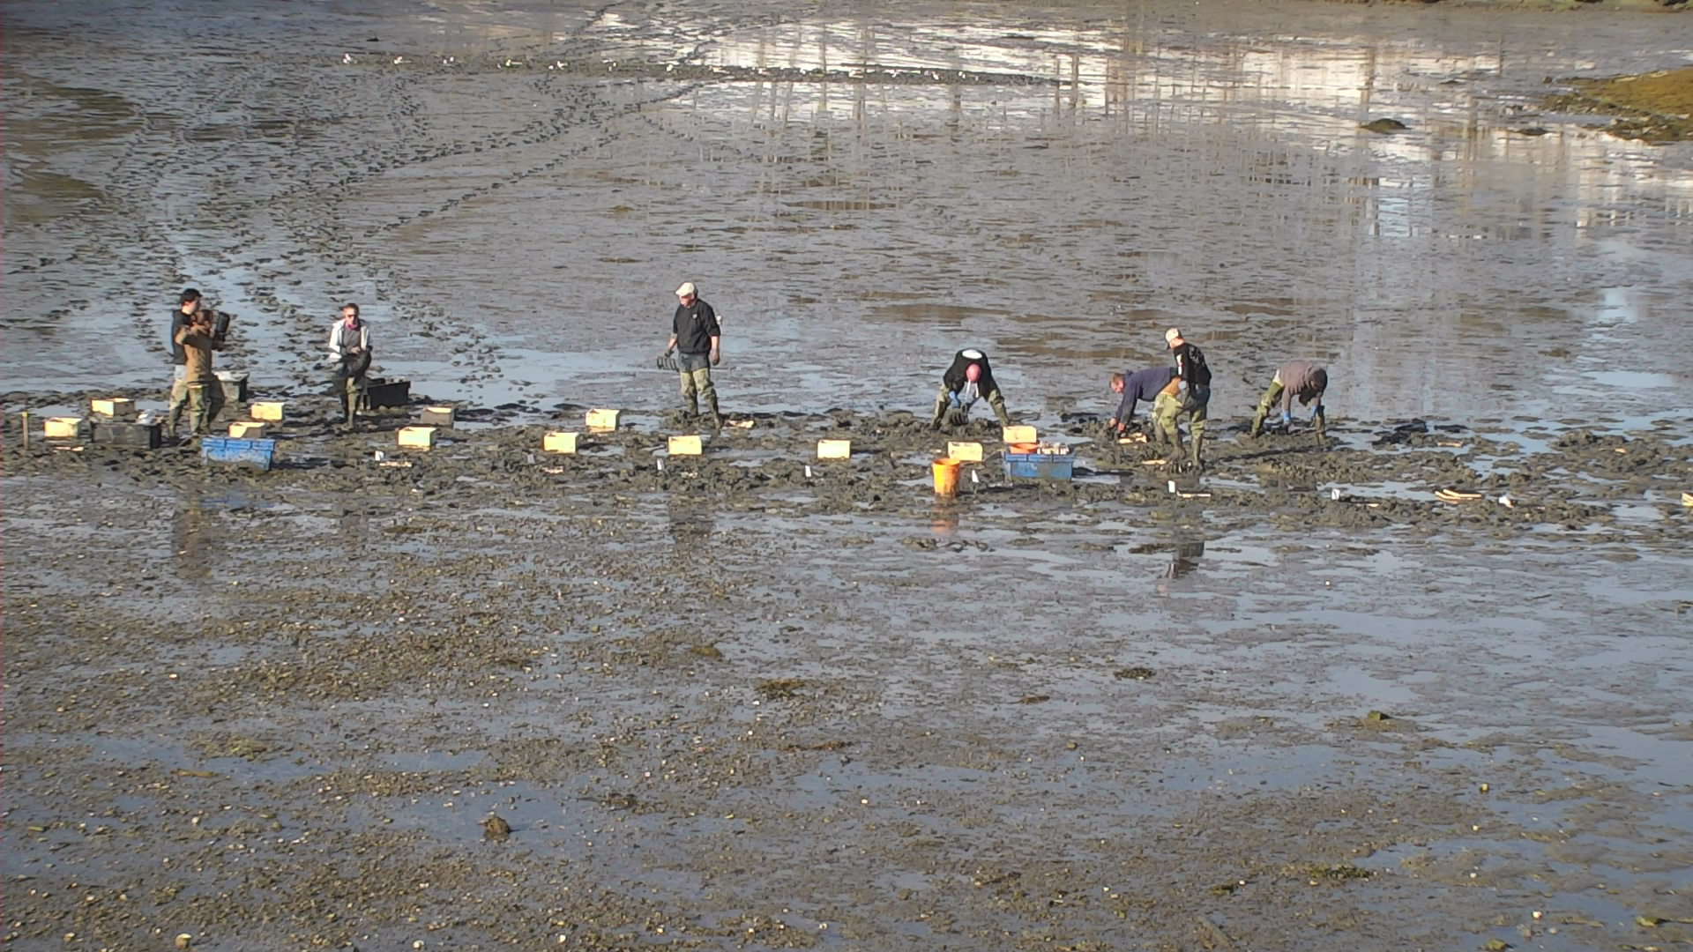
Student License Allocations (Includes Resident and Non-Resident)
1998-1999 = 5
1999-2000 = 5
2000-2001 = 5
2001-2002 = 5
2002-2003 = 5
2003-2004 = 6
2004-2005 = 10
2005-2006 = 10
2006-2007 = 10
2007-2008 = 10
2008-2009 = 10
2009-2010 = 10
2010-2011 = 0
2011-2012 = 0
2012-2013 = 0
2013-2014 = 9
2014-2015 = 11
2015-2016 = 11
2016-2017 = 11
2017-2018 = 15
2018-2019 = 15
2019-2020 = 17
2020-2021 = 17
2021-2022 = 17
2022-2023 = 17
2023-2024 = 17
2023-2024 =
Average of 8 licenses over 25years.

Slide 31
Student Harvester Effort
Previous Year Reported Student Harvest = 158Bu HS & 340Bu SS
Potential 1BU limit = 168Bu x TSLA=
Potential 2BU limit = 336Bu x TSLA=

Slide 32
License Calculations
2024 Est. Standing Softshell Clam Crop = 16,305 Bushels or 815,250 lbs.
2024 Est. Standing Hardshell Clam Crop = 14,666 Bushels or 8.79 million pcs.
Survey Supported Number of Resident Commercial Licenses = 51 (27 Softshell & 24 Quahog)
15 % +/- Marine Resource Committee Discretion = 44 to 59
Staff Recommendation 51 Resident Commercial Licenses (Reduction of 6)
6 Non-Resident Commercial License (Stays Same)
4 Resident Student Licenses (Reduction of 12)
1 Non- Resident Student License (Reduction of 1)
1 Bushel Licenses (Stays Same)
Unlimited Recreational Licenses
2019 Estimates ~ Softshell = 25,550 Bushels ~ Quahogs = 3,140 Bushels (1.27 million pieces)
2021 Estimates ~ Softshell = 23,335 Bushels ~ Quahogs = 13,252 Bushels (7.9 million pieces)
2023 Estimates ~ Softshell = 16,305 Bushels ~ Quahogs = 14,666 Bushels (8.7 million pieces)

Slide 33

Thank You
Presenter Name
Email Address
Website Address

