Slide 1
Town of Brunswick
Manager’s Proposed 2022-23 Budget
Town of Brunswick, Maine
April 28, 2022

Slide 2
Tax Rate Impact
Manager’s Proposed 2021-22 Budget (page 4)
Assuming 1% increase in taxable valuation,
$508,583
= 1% Change in Tax Rate

Slide 3
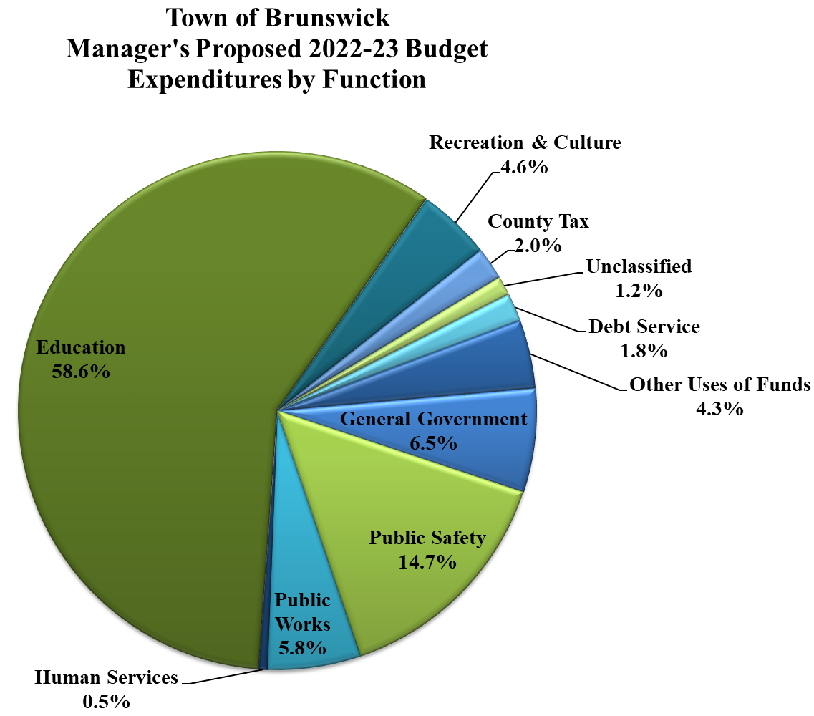
Budget page 11
Notes:
From Budget(year) workbook

Slide 4
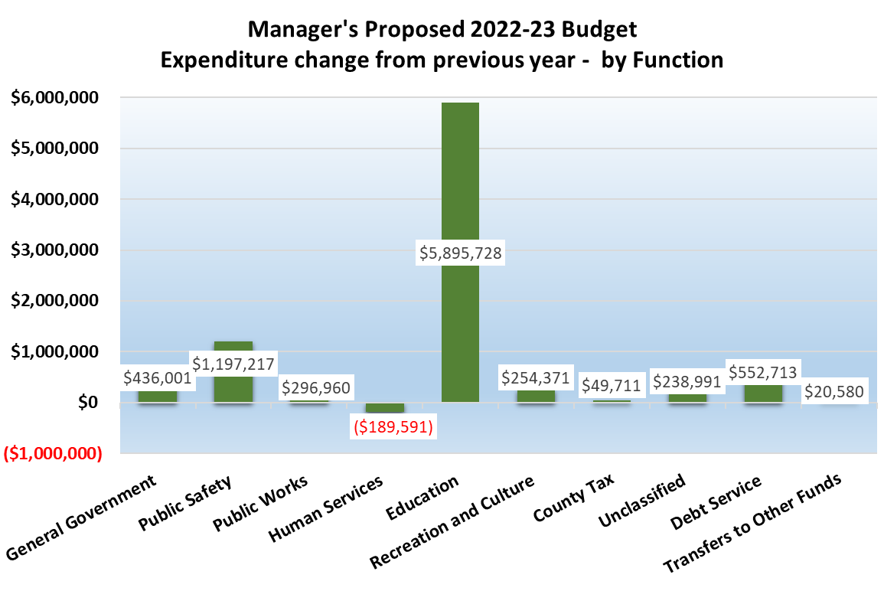

Slide 5
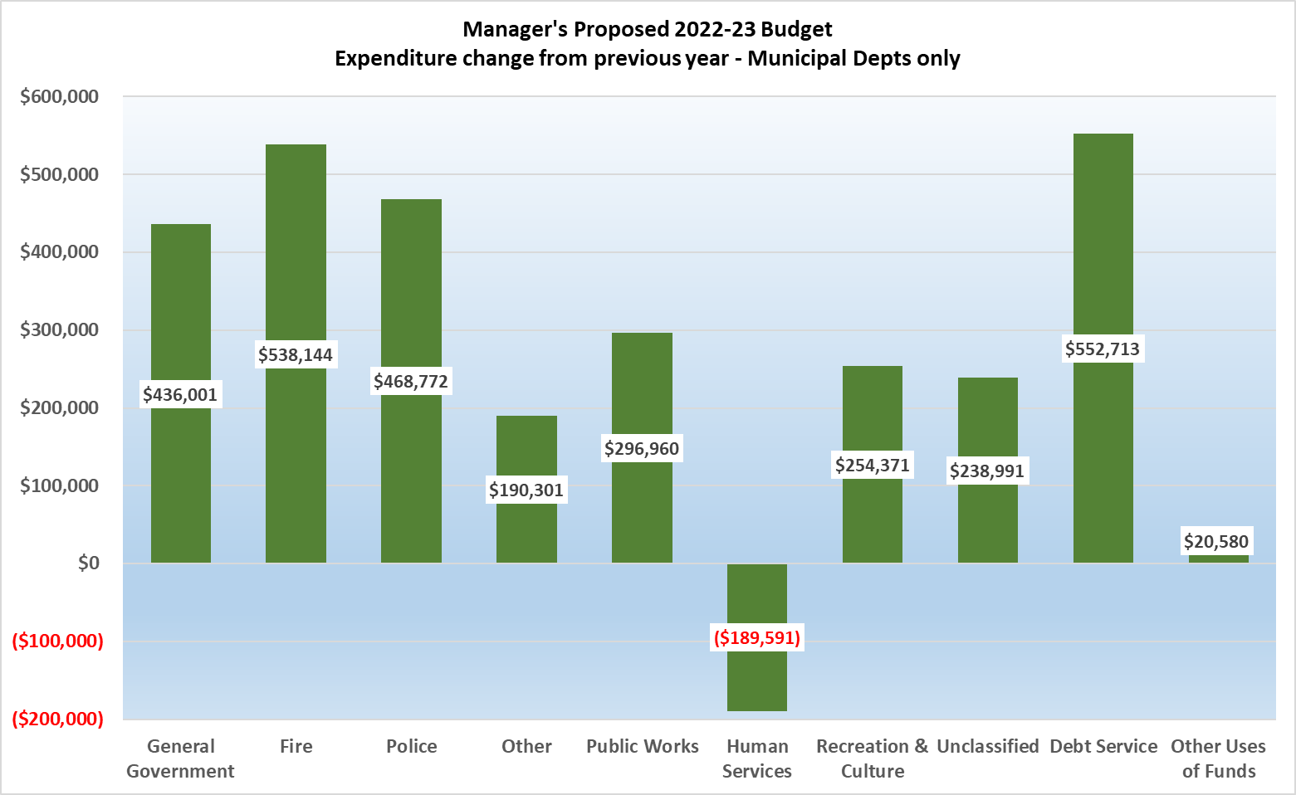

Slide 6
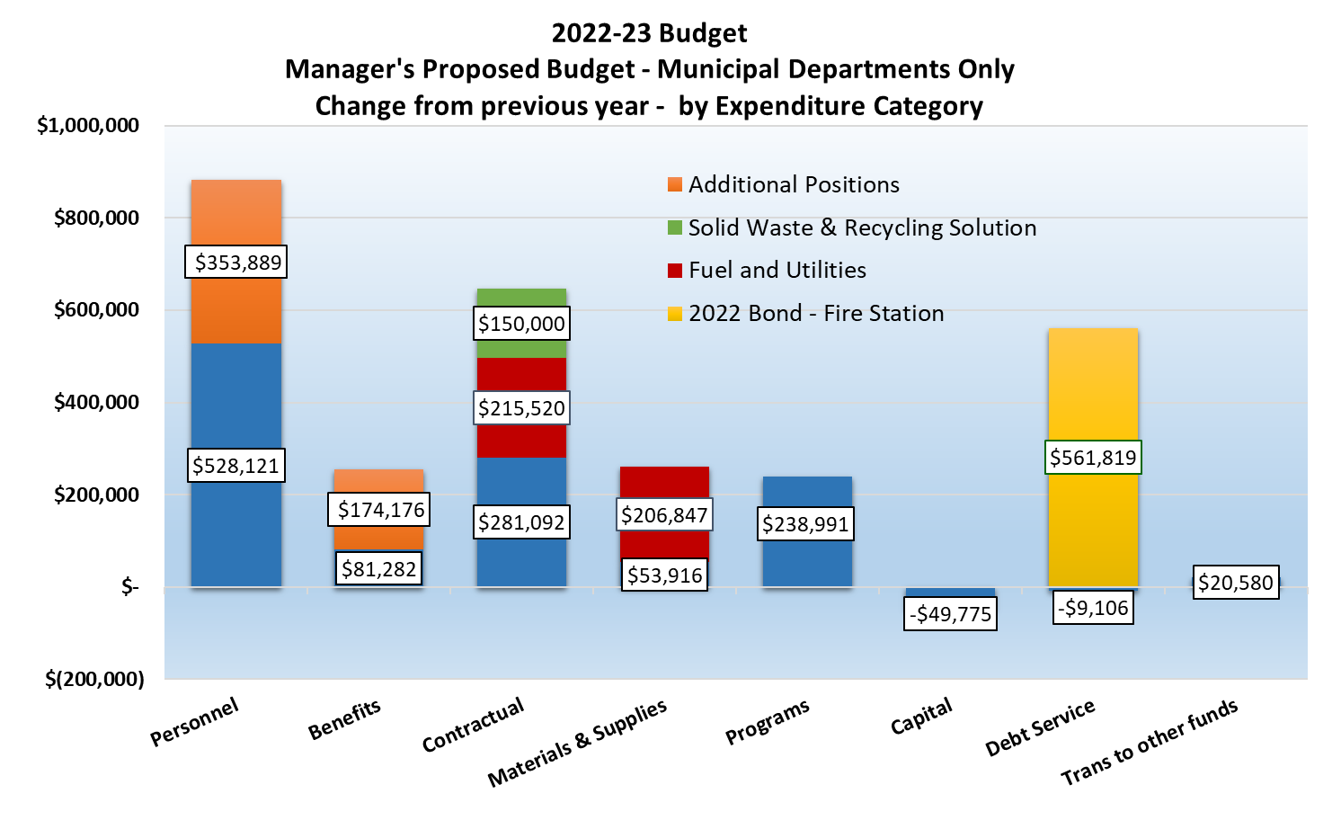

Slide 7
New Municipal Positions 2022-23
Position | Salary | Benefits | Total
Environmental Planner | $75,000 | $32,388 | $107,388
Public Works Mechanic | 49,022 | 27,750 | 76,772
Payroll/Human Resources Coordinator | 55,084 | 28,832 | 83,916
Geographic Information Systems (GIS) Administrator | 75,000 | 32,388 | 107,388
Firefighter/Emergency Medical Technicians (2) | 99,783 | 52,818 | 152,601
 | $353,889 | $174,176 | $528,065
*
*Net increase from adjusting current personnel, adding position
Notes:
Page 2 – Recommended. Subject to change!!!!

Slide 8
Capital Budget (pgs 90-91 of proposed budget)
Manager’s update – request to fund MDOT grant match with SLFRF grant.
Notes:
Page 2 – Recommended. Subject to change!!!!

Slide 9
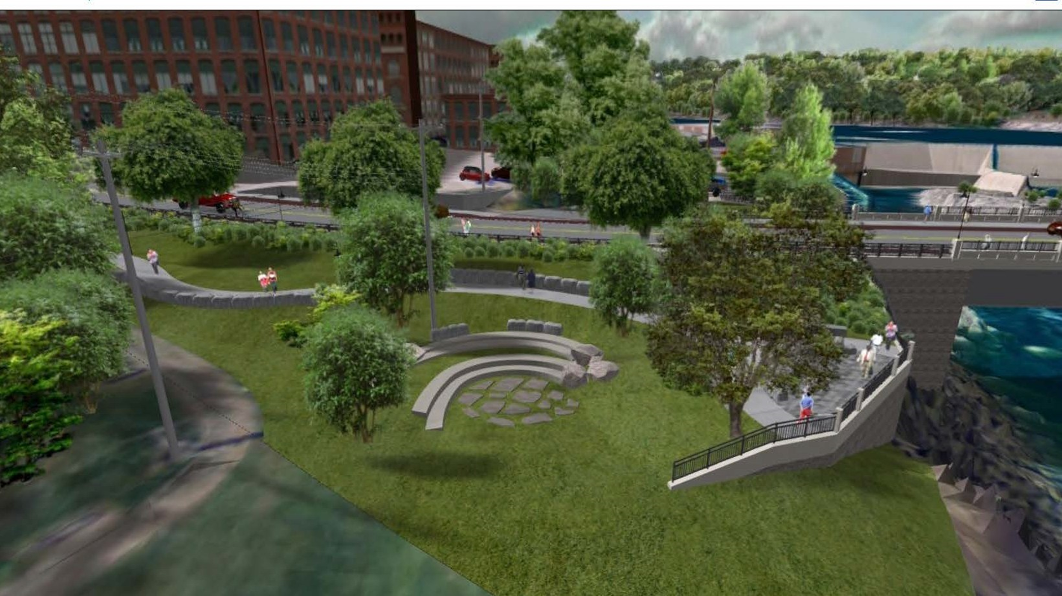

Frank J Wood Bridge Amenities
$330,000 from General Fund Balance to fund Brunswick’s desired improvements and amenities associated with the replacement of the Frank J. Wood Bridge

Slide 10
2021-22 tax rate
Calculation of tax rate increases and associated required adjustment amount
Tax rate
in proposed budget
Assuming 1% increase in taxable valuation,
approx. $508,000 = 1% change in tax rate

Slide 11
Important Dates
Date | Meeting | Item
Monday, 4/11/22 | Budget Workshop | Town Manager presentation
Thursday, 4/14/22 | Budget Workshop | School Dept presentation
Tuesday, 4/19/22 | Town Council Meeting | Set Public Hearing
Thursday, 4/21/22 | Town Council Meeting | P&R and PW presentations
Thursday, 4/28/22 | Budget Workshop | Brunswick Link, School & TM presentations
Monday, 5/2/22 | Town Council Meeting | Public Hearing
Thursday, 5/5/22 | Budget Workshop | Guidance to School and Municipal Departments
Monday, 5/9/22 or Wednesday, 5/11/22 | School Board Meeting
Thursday, 5/12/22 | Town Council Spec Mtg | Adopt Budget & CIP
Tuesday, 6/14/22 | Budget Referendum

Slide 12
END

