Slide 1

Town of Brunswick, Maine
Interim Town Manager’s
Proposed 2024-25 Budget
Delivered to Town Council
April 1, 2024
April 22, 2024

Slide 2
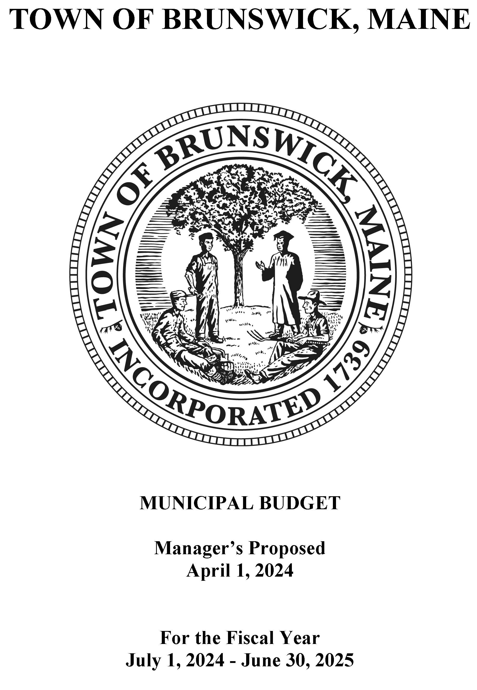
Manager’s Proposed Budget - overview
Includes total general fund budget
  Municipal depts as adjusted by Town Manager
  School Dept budget approved by School Board
  County Tax assessment
Includes 0.5% estimated valuation increase
Every $590,000 budget adjustment = 1% on tax rate

Slide 3
2024-25 Budget net tax (page 4)
Includes est. 0.5% valuation increase

Slide 4
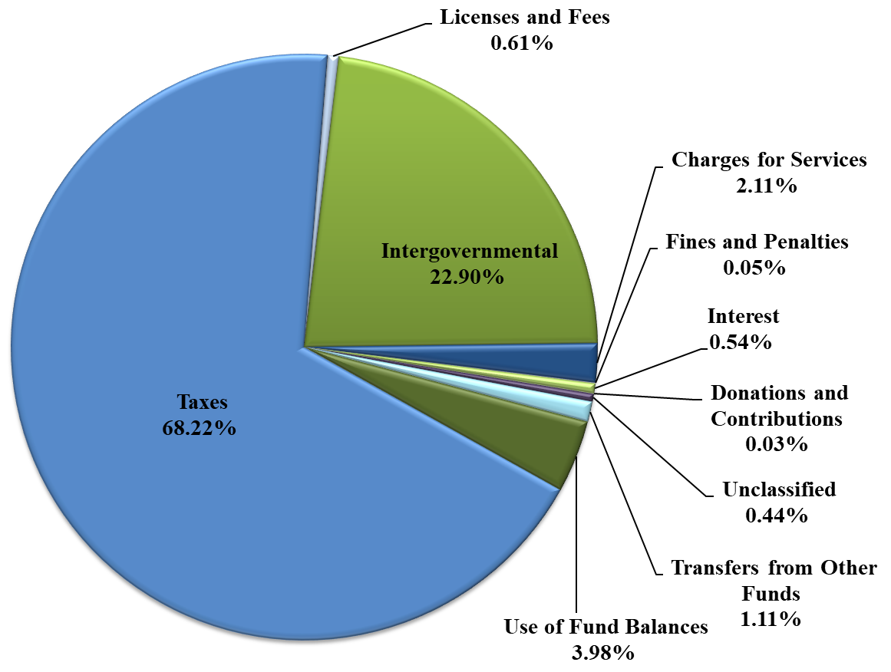
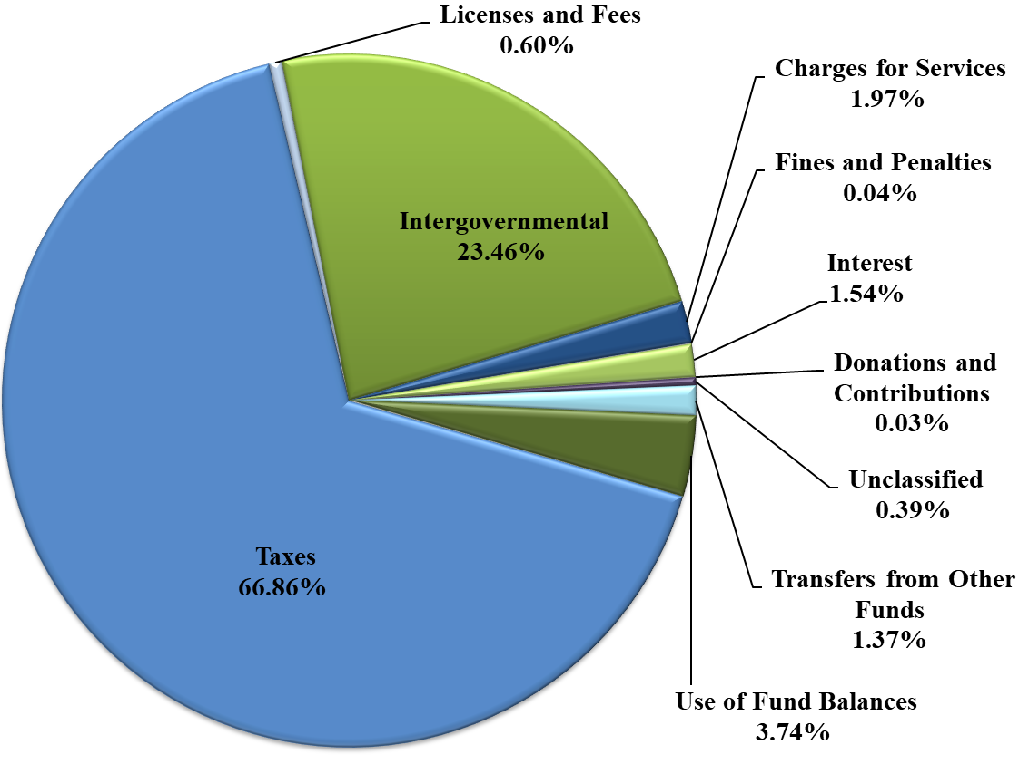
revenues by source
2023-24 adopted Budget
2024-25 manager’s
proposed Budget

Slide 5
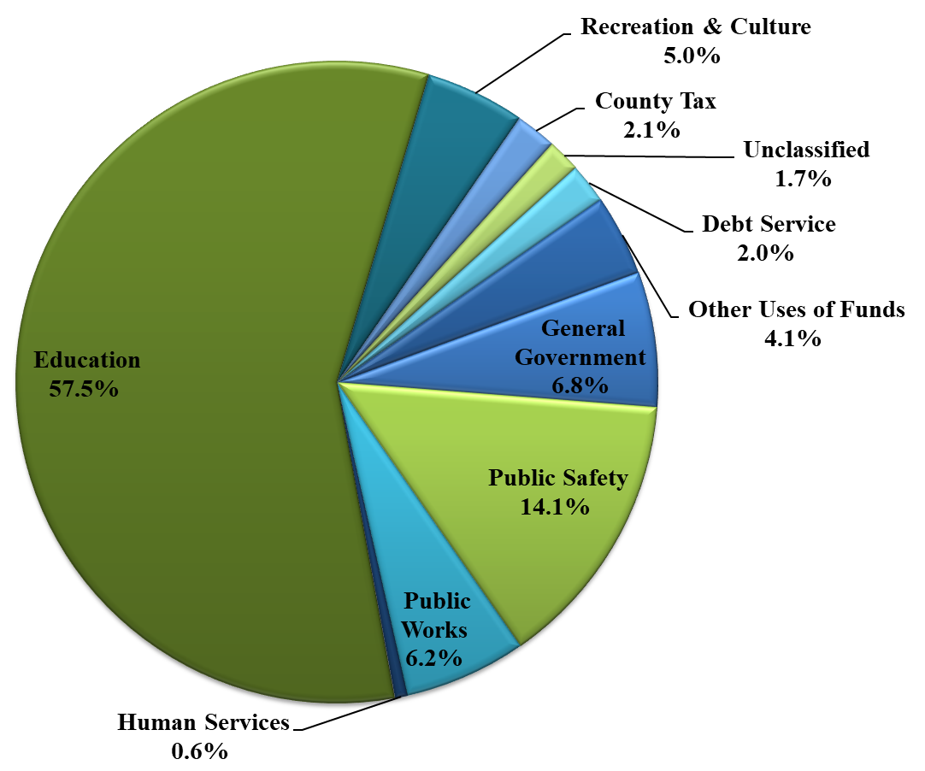
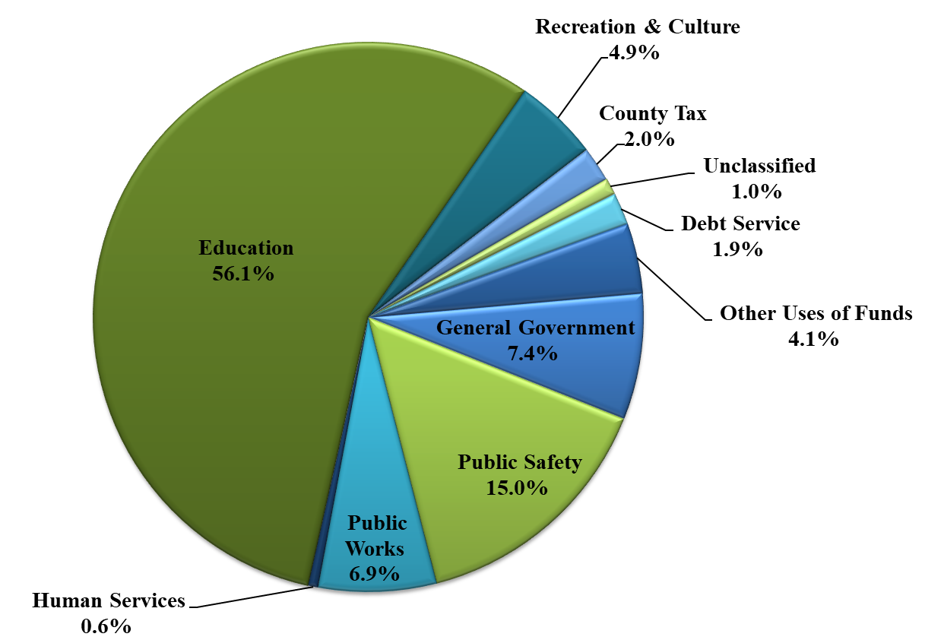
expenditures by function
2023-24 adopted Budget
2024-25 manager’s
proposed Budget

Slide 6
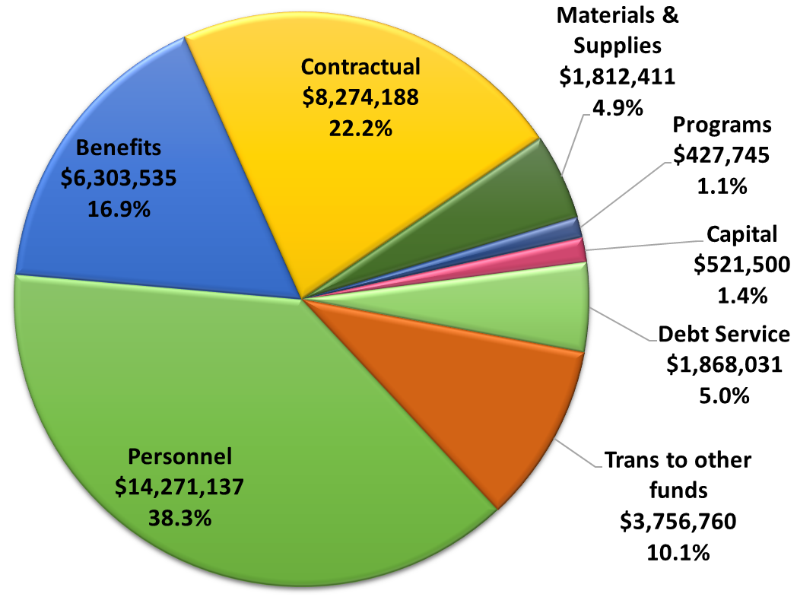
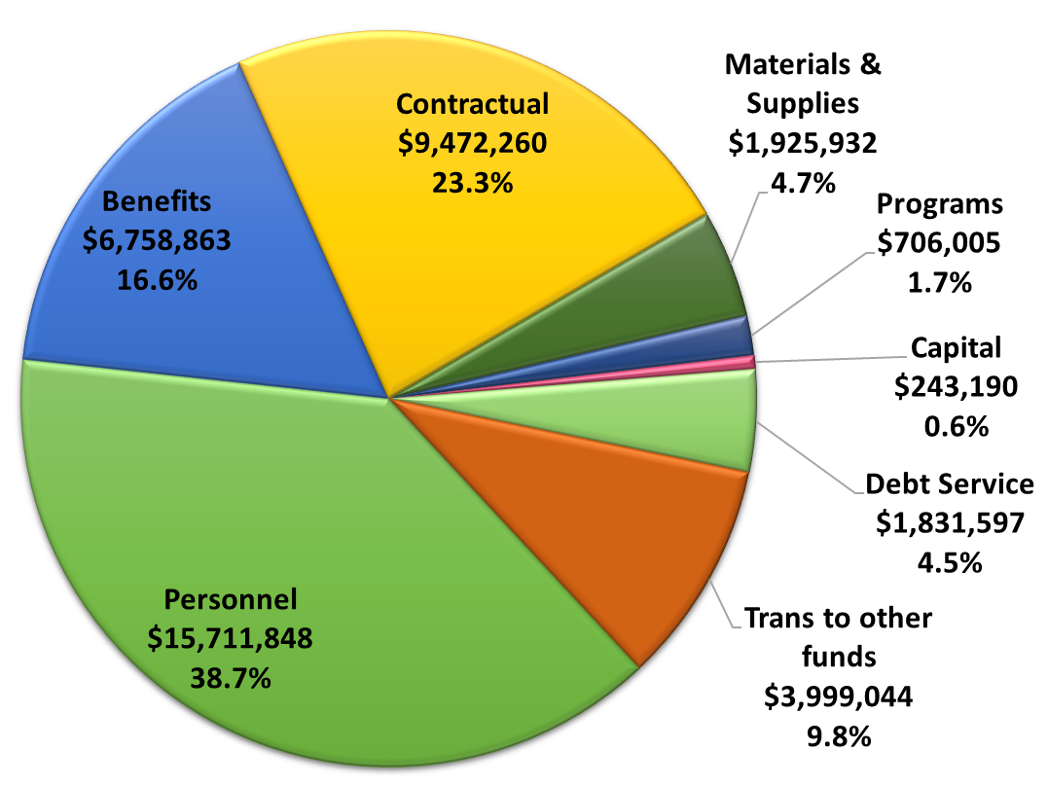
Municipal expenditures by Category
Municipal Depts ONLY
2023-24 adopted Budget
2024-25 manager’s
proposed Budget

Slide 7
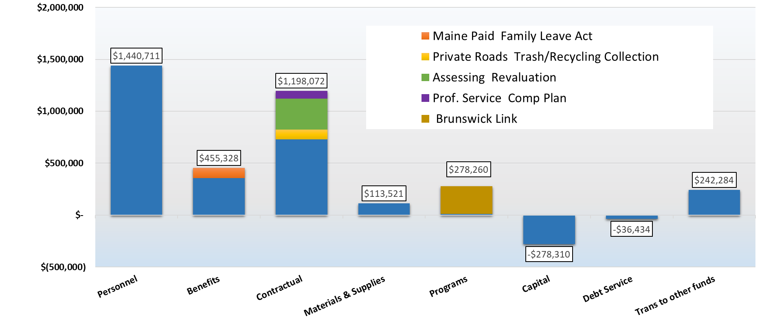
Major drivers – municipal expenditures
2023-24 Budget 2024-25 Budget change by expenditure category
Municipal Depts ONLY

Slide 8
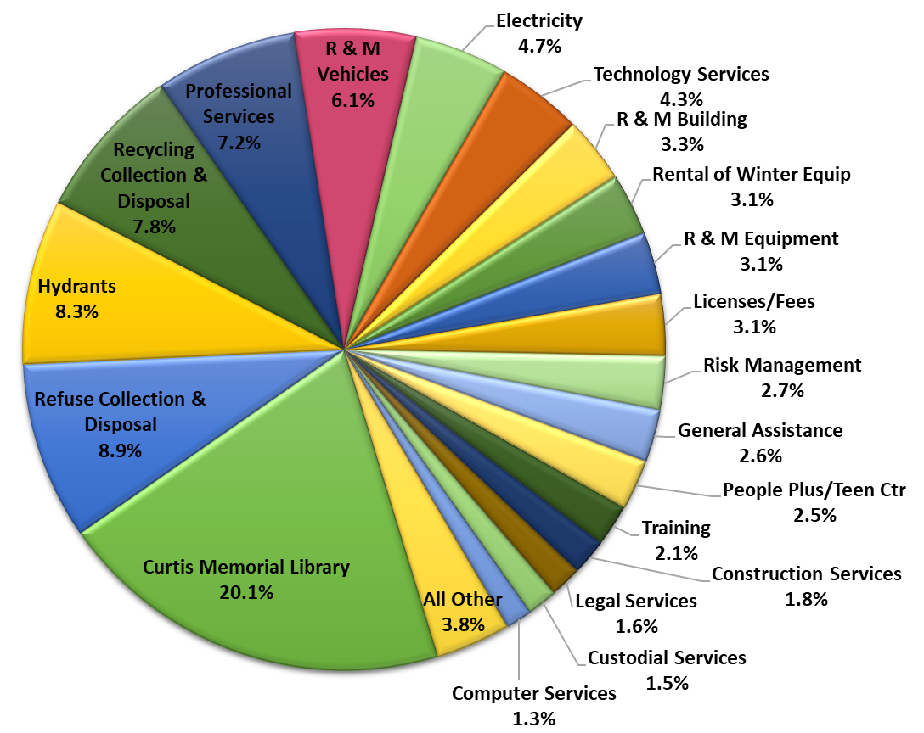
Municipal contractual Services
Municipal Depts ONLY
2024-25 manager’s
proposed Budget
Contractual services increased 14.5% over 2023-24 budget – primarily driven by:
$300,000 Revaluation
$190,000 Trash/Recycling Collection & Disposal
$110,000 R&M Vehicles
$100,000 Professional Services

Slide 9
Manager adjustments to municipal department budgets
TOTAL Revenue increase: $475,000
State Revenue Sharing Balance – $150,000 to offset taxes
Unassigned fund balance - $325,000 to offset Revaluation & portion of Professional Services for the Comprehensive Plan
Municipal Depts ONLY
TOTAL Expenditure reductions: $655,222
Diesel & Gasoline – $90,612 – based on signing fuel contract
Planning Prof Services – $150,000 – find alternate funding
Fire Dept Capital Equip - $80,000 – find alternate funding
PW Capital Equip – $45,990 – delay or find alternate funding
PW Central Garage Mechanic – $87,898 – not this year
Rec Building – $65,722 – fund repairs from Facilities Reserve
Police Dept - $60,000 – salary vacancy factor
Contingency - $25,000 – adjust for BDA
Street Resurfacing/Rehab - $50,000 – reduce annual increase

Slide 10
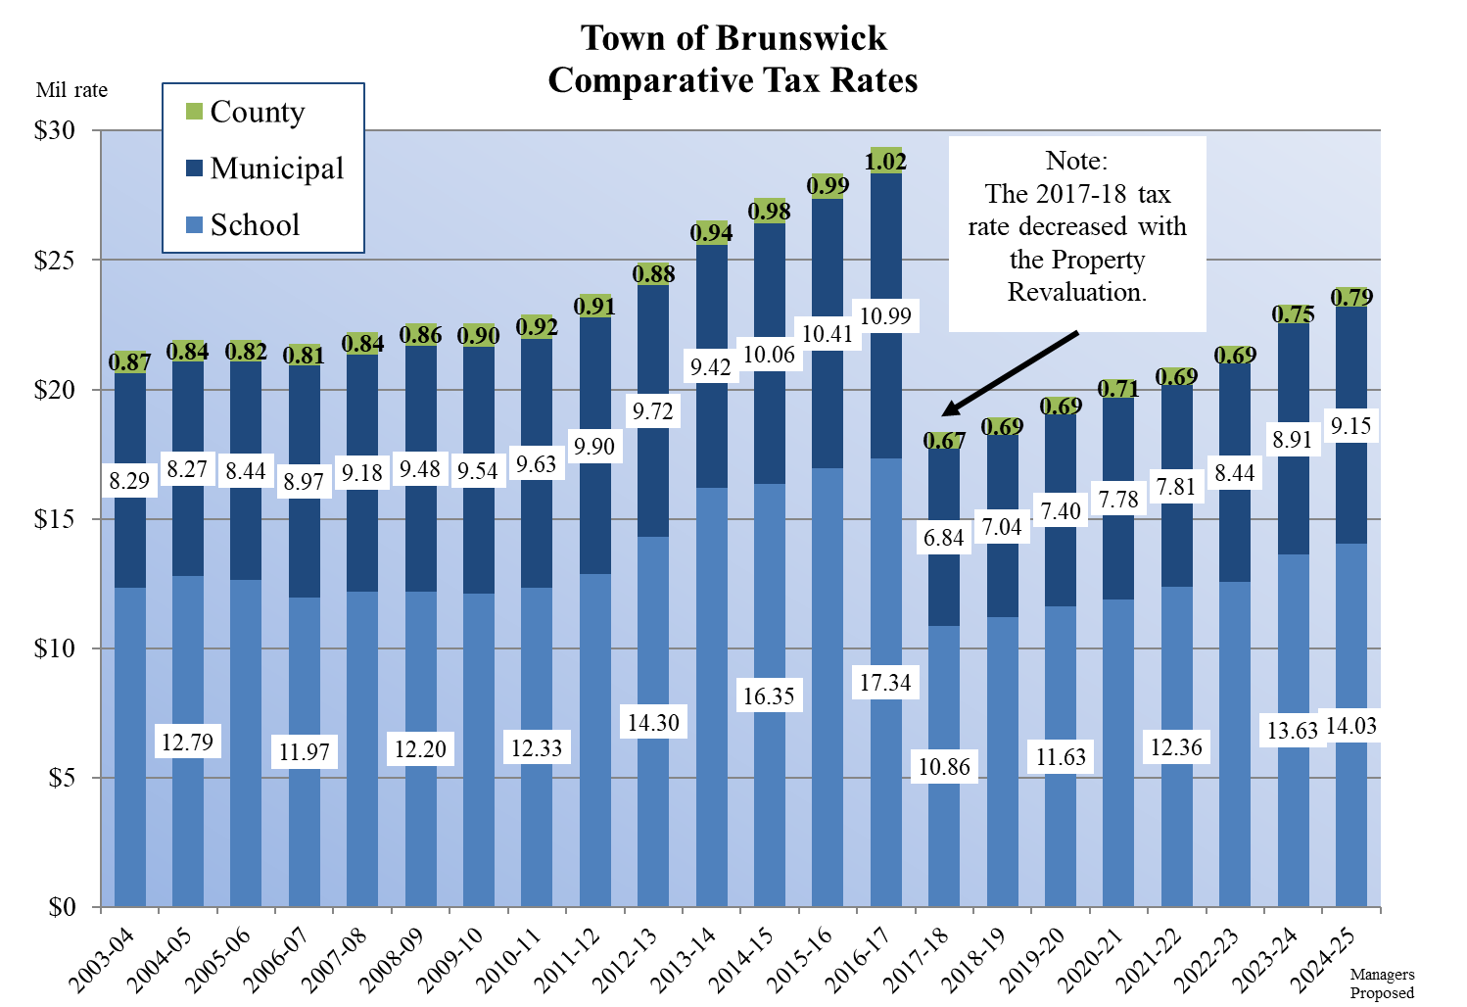

Slide 11
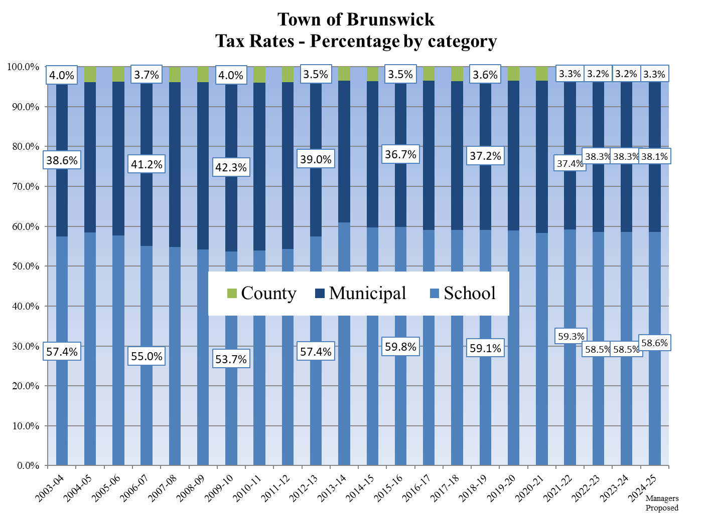

Slide 12
2024-25 Budget
2023-24 tax rate
Calculation of tax rate increases and associated required adjustment amount
Tax rate in Manager’s Proposed 2024-25 budget

Slide 13

2024-25 Budget workshop/meeting schedule
Thursday, 2/29/24 – Town Mgr’s Preliminary Budget, Assessing Dept
Thursday, 3/14/24 – Budget/CIP Workshop – Town Clerk, Planning, Finance
Thursday, 3/28/24 – Budget/CIP Workshop – Public Works, IT/Cable TV
Monday, 4/1/24 – TC meeting, receive Mgr’s Budget, set Pub Hearing
Thursday, 4/4/24 – Budget/CIP workshop – Fire Dept, Police Dept CANCELLED
Thursday, 4/11/24 – Budget/CIP Workshop – School Dept, Brunswick Link
Monday, 4/22/24 – Budget/CIP Workshop – People Plus, Fire Dept, ITM Budget
Thursday, 4/25/24 – TC meeting - Budget/CIP Public Hearing
Thursday, 5/2/24 – Budget/CIP workshop – EcoDev, Parks & Rec, CML, BDA
Thursday, 5/9/24 – Budget/CIP workshop – Police Dept
Thursday, 5/16/24 – TC meeting - Budget/CIP adoption
Tuesday, 6/11/24 – School budget referendum

Slide 14
Questions?
  Julia Henze
  jhenze@brunswickme.org
  207-725-6659

